Slide 1





Sensemaking through work and equal rights environments:
Key points for intervention and research
Maria Kapanadze Kapanadze, PhD
Research Professor
Occupational Therapy Department
19/05/2025

Slide 2
Sensemaking through work:
a narrative perspective

Slide 3
Sensemaking
Contexts
An action-based reasoning
Narrative reasoning

Slide 4

1. Narrative reasoning
Narratives about employment experiences: occupational plot
Autobiographical reasoning- “Autobiographical self” –
Past, present and future
Sensemaking is how people give meaning to their experiences, especially in complex or ambiguous situations. It’s about interpreting and constructing reality through interaction, reflection, and shared understanding (Weick et al., 2005).

Slide 5

Sensemaking
It’s how people answer the question:
“What’s going on here?” – and then decide how to act based on that interpretation.

Slide 6

THE VALUE OF LIFE STORIES
Thinking beyond the illness, removing the “labels” from what we know is not easy.
Sometimes it requires going against what we are familiar with.

Slide 7
Examining the Life Story: Five Questions (McAdams, 1996)
1. Structure and Content: What is a life story?
A life story is an internalised and evolving narrative of oneself that incorporates the reconstructed past, the perceived present, and the anticipated future.
2. Function: What does a life story do?
The primary function of the life story is integration. By uniting disparate elements within the self into a broader narrative framework, the process of self-determination can create an identity pattern from what may initially seem like a random and scattered collection.

Slide 8
3. Development: How does the life story change over time?
Life stages
4. Individual Differences: What types of life stories are there?
There is no single pattern.
5. Mental Health: What is a “good” life story?
How people make sense of their lives through narrative.

Slide 9

Career as a story
Storying is the essence of identity work
Occupational plot
Career theme:
Past memories, present experiences, and future aspirations
Vocational tasks, occupational transitions, and work traumas
Objective: optimize decision-making and problem-solving
Subjectivity
Character arc: overarching narrative thread, principal motivation
Micro-narratives

Slide 10
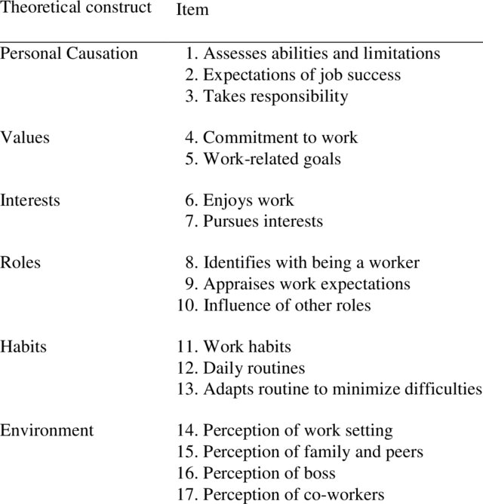
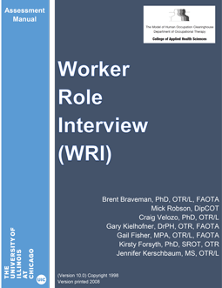
Occupational identity
Motivation
Worker Role Interview (WRI) (Breveman et al., 2005)
Personal causation
Values
Interests
Roles
Habits
Perception of the environment

Slide 11
Life Design Paradigm
Relational Dimension: engagement, interaction and encouragement
Communication Dimension: structure, dialogue, reflection- current understanding of life contexts, circumstances, and roles
Client goals: setting goals, engaging emotions -sensemaking, the main goal of life, gives intentionality, and helps to reach a commitment to oneself
Designing a meaningful life project and supporting the construction of the career through small stories, their deconstruction, and reconstruction into a narrative of identity, and co-construction of intentions leading to actions

Slide 12
Activity
In 1 minute, choose a person from the group.
The listener only listens—does not ask questions, judge, or intervene.
Once you’ve chosen the person, tell them a story that positively moves you about yourself (something from the past, present, or future).
After one minute, switch roles.

Slide 13
Did your partner share relevant information about who he/she is?
What are his/her priorities? What did he/she enjoy? How does he/she feel?
Did it give you a brief idea of the context in which that person is situated?

Slide 14

Narrative as a phenomenon of study or as a research method
Narrative as a therapeutic approach
Narrative-in-action
The retrospective construction of meaning
Socially determined forms of action, ways of acting and making sense of the world

Slide 15

Research focus
Present, past, future
The intended audience of the narrative
Turning points, tensions, interruptions…

Slide 16



Biographical-narrative method
Autoethnography
Life story
Oral history
Arts-based research (Fingley, 2015 in Denzin & Lincoln, 2015)
Observation methods:
Participant observation (Angrosino & Pérez, 2000)
Visual methods, “the mirror with memory” (Harper, 2015).
This metaphor emphasises how photographs and visual media
serve as both a reflection and a record of social life.
Co-constructed Meanings
Autoethnography – a political practice (Holman Jones, 2015)
Online ethnography:
The construction of the other’s self
The construction of identity (Markham, 2015)

Slide 17

2. An action-based reasoning

Slide 18
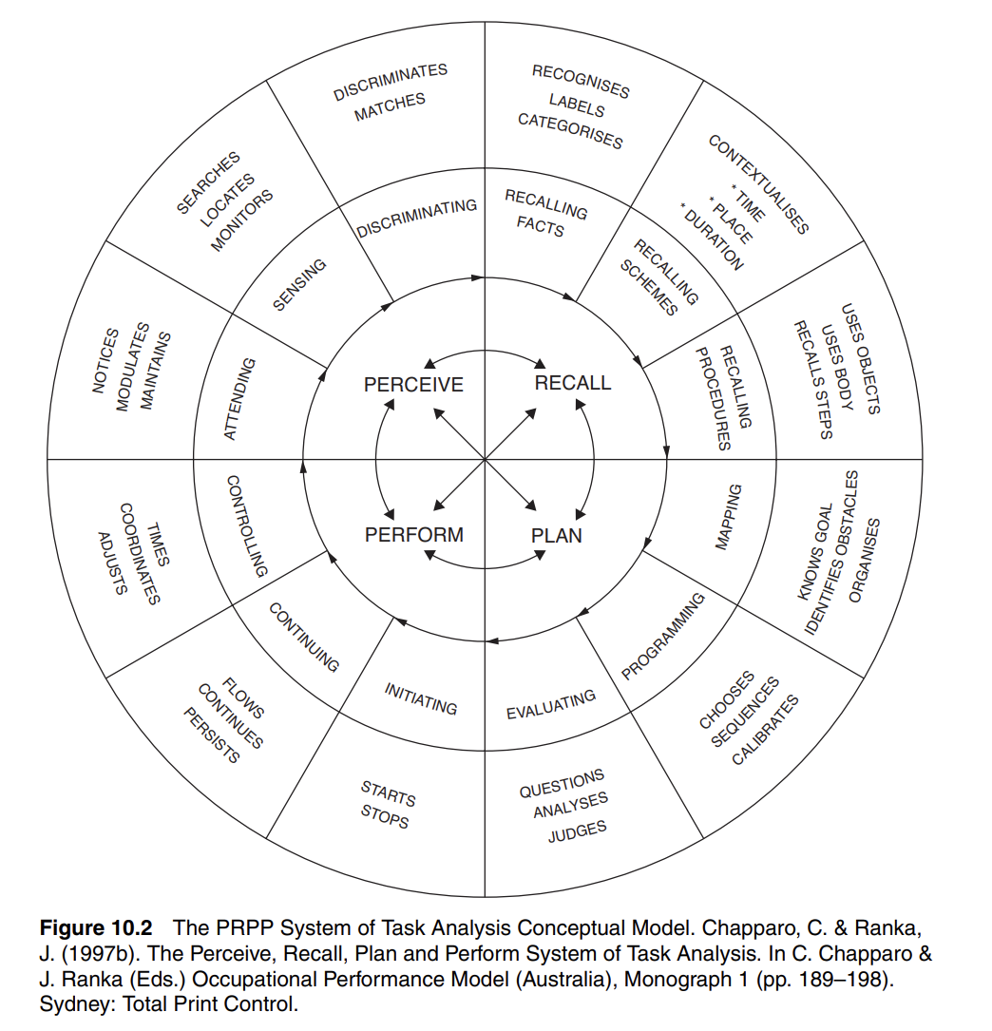
The PRPP system and cognitive organisation
Multitasking or switch tasking?

Slide 19
Environments shape meaning:
Support and relationships VS “role of dependent”, feeling alone
Right-based attitudes of coworkers and the university environment VS stigma
DIGNITY - Natural environment and human-made changes to the environment
Products and technology
Services, systems, and policies

Slide 20
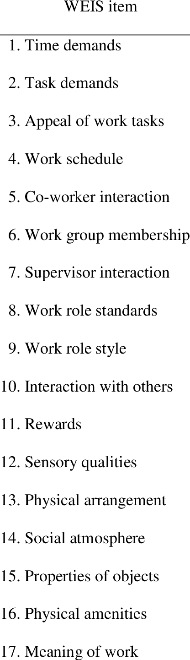
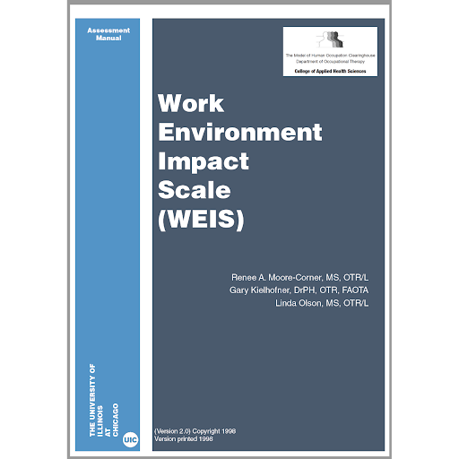
Work Environment Impact Scale (WEIS) (Moore, Corner, Kilehofner, & Olson, 1998)

Slide 21
Narratives-in-Action in Qualitative Research
Exploring identity, meaning, and lived experience through storytelling

Slide 22
What Are Narratives-in-Action?
A form of narrative inquiry focused on how people construct and express meaning in their everyday actions and stories.
Moves beyond life stories told retrospectively to observe narrative as it unfolds in real time.
Includes gestures, expressions, choices, and language used in specific moments and settings
Captures identity construction, coping strategies, and social positioning.

Slide 23
Research Features and Applications
Context-sensitive: narratives are tied to situations and environments.
Co-constructed: meaning emerges through interaction between participant and researcher.
Used in education, mental health, rehabilitation, and community research.
Methods may include observation, interviews, audio/video recordings, or participant journaling.

Slide 24
Basic References
Chase, S. E. (2015). Narrative inquiry: Still a field in the making. In N. K. Denzin & Y. S. Lincoln (Eds.), The SAGE handbook of qualitative research (4th ed., pp. 681–705). Thousand Oaks, CA: SAGE.
Clandinin, D. J., & Connelly, F. M. (2000). Narrative inquiry: Experience and story in qualitative research. San Francisco, CA: Jossey-Bass.
Frank, A. W. (2010). Letting stories breathe: A socio-narratology. Chicago, IL: University of Chicago Press.
Holman Jones, S. (2005). Autoethnography: Making the personal political. In N. K. Denzin & Y. S. Lincoln (Eds.), The SAGE handbook of qualitative research (3rd ed., pp. 763–791). Thousand Oaks, CA: SAGE.
McAdams, D. P. (1996). Personality, modernity, and the storied self: A contemporary framework for studying persons. Psychological Inquiry, 7(4), 295–321. https://doi.org/10.1207/s15327965pli0704_1
Maree, J. G. (2013). Counselling for career construction: Connecting life themes to construct life portraits. Turning pain into hope. UK: Springer.
Riessman, C. K. (2008). Narrative methods for the human sciences. Thousand Oaks, CA: SAGE Publications.
Savickas, M. L., Brown, S. D., & Lent, R. W. (2013). Career development and counseling: Putting theory and research to work. (2nd ed., Ed.)
Savickas, M.L. (2015). Life Design Counseling Manual. Copyright: M.L. Savickas.
Savickas, M.L. (2015b. Career Counseling Paradigms: Guiding, Developing, and Designing. APA Handbook of Career Intervention. Vol 1. Foundations. (129-143). American Psychological Association. http://dx.doi.org/10.1037/14438-022
Smith, B., & Sparkes, A. C. (2009). Narrative inquiry in sport and physical culture. In P. L. T. McNamee (Ed.), Routledge handbook of the philosophy of sport (pp. 295–306). New York, NY: Routledge.
Weick, K. E., Sutcliffe, K. M., & Obstfeld, D. (2005). Organizing and the process of sensemaking. Organization Science, 16(4), 409–421. https://doi.org/10.1287/orsc.1050.0133

Slide 25
Thank you for your attention

Slide 26
PER A MÉS INFORMACIÓ
C/ de la Riba, 90
08221 Terrassa I BARCELONA
T. 93 783 77 77

