Slide 1





Life Design Counselling
Maria Kapanadze Kapanadze, PhD
Research Professor
Occupational Therapy Department
01/05/2024

Slide 2

Vision
Career construction
Psychosocial process – self and society
Identity, adaptability, flexibility, intentionality, employability, and narrative (Savickas, 2012).
Employability, understood as a psychosocial construct, depends on the extent to which the individual will be able to review his/her career history to better respond to current labour market demands and project possible future scenarios.

Slide 3
Adaptability proactive personality flexibility
Self-esteem
Education
Career identity self-efficacy self-regard
Employability
(Fugate et al., 2004; McArdle, Waters, Briscoe, & Hall, 2007)
Reinsertion
Human and Social Capital
effective partnering and networking, social
Job search

Slide 4

Identity work
Autobiographical reasoning and identity work include reflective activities of creating, maintaining, and revising identity narratives, which are characterized by differences, coherence, and continuity.

Slide 5

Career as a story
Storying is the essence of identity work
Occupational plot
Career theme:
Past memories, present experiences, and future aspirations
Vocational tasks, occupational transitions, and work traumas
Objective: optimize decision-making and problem-solving
Subjectivity
Character arc: overarching narrative thread, principal motivation
Micro-narratives

Slide 6
Life Design Paradigm
Relational Dimension: engagement, interaction and encouragement
Communication Dimension: structure, dialogue, reflection- current understanding of life contexts, circumstances, and roles
Client goals: setting goals, engaging emotions -sensemaking, the main goal of life, gives intentionality, and helps to reach a commitment to oneself
Designing a meaningful life project and supporting the construction of the career through small stories, their deconstruction, and reconstruction into a narrative of identity, and co-construction of intentions leading to actions

Slide 7
The Career Story Interview
Session | Objective | Description
1. Role models | Identify adjectives that describe and construct concepts about oneself. | Role models usually influence career choices. They are based on internalised identifications or attributes (personal characteristics) that are part of the identity.
2. Magazines, TV, websites | Identify the person's interests as well as the environments and activities of interest. | Questions about the magazines, TV programmes or websites that people consult represent the quick way to identify interests.
3. Favourite book, favourite story | It allows an understanding of cultural stories and arguments through which the person can project the outcome of the transition/change. | The exploration of the favourite story focuses on the identification of vital roles.
4. Mottos | Discover the advice that the person gives himself/herself. | Usually, the formulation of advice involves the problem of transitional narrative. If the client finds it difficult to articulate a favourite expression, it is possible to encourage him/her to create his/her own credo or motto.
5. Early recollections | It allows us to understand how the client sees the problem within his or her transition narrative. | Early recollections explore the client's perspective and involve memories along with the experience of significant personal reconstruction and trauma.

Slide 8

Recovery Model
Rebeiro-Gruhl (2008) identified five transitional enablers of recovery, these are:
1. Symptom Relief
2. Securing Basic Needs
3. Gaining self-awareness
4. Accessing opportunities
5. Meaningful work

Slide 9

Applying Recovery Principles to the Treatment of Trauma
(Smith, Hyman, Andres-Hyman, Ruiz, & Davidson, 2016).
Increase Community and Social Support
Renew Hope and Commitment
Foster Engagement in Meaningful Activities
Redefine Self and Incorporate Illness
Overcome Stigma
Assuming Control, Becoming Empowered, and Exercising Citizenship
Managing Symptoms

Slide 10
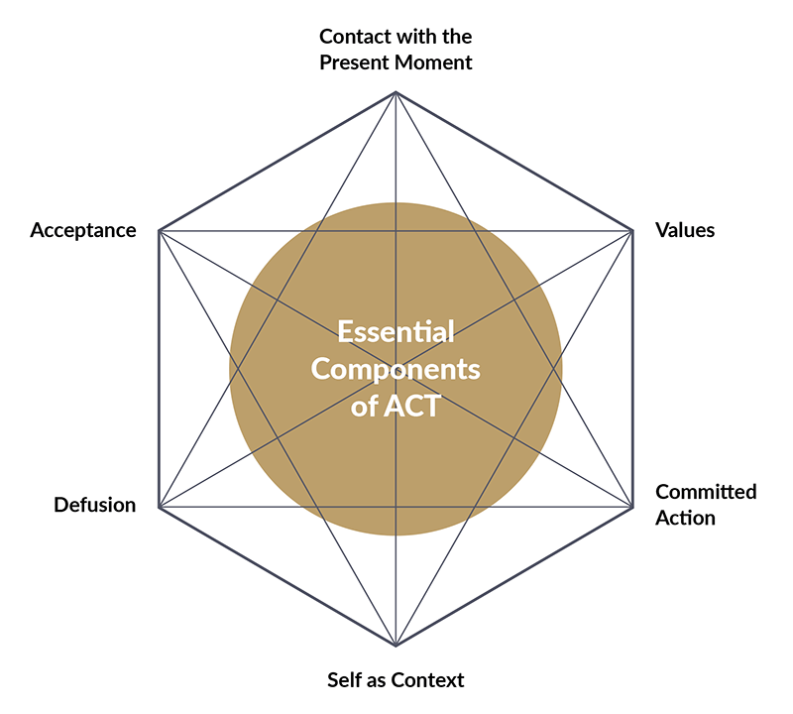
Relevant Frames of References
Acceptance and Commitment Therapy (Bond, Hayes, & Barnes-Holmes, 2006)

Slide 11
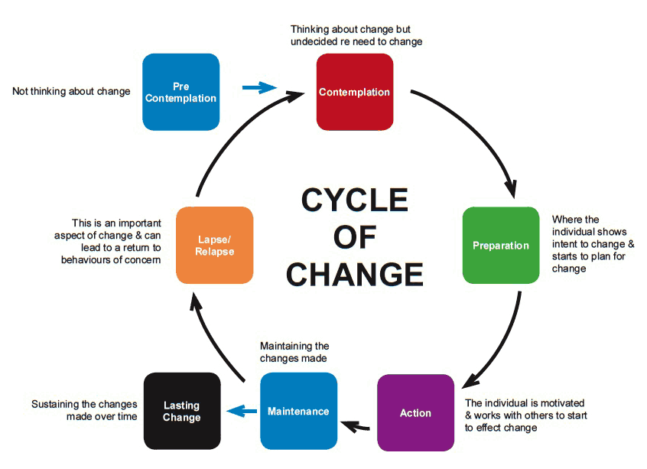
Motivational Interview (Stoltz & Young, 2013)

Slide 12
Work integration of people with mental health: peer-to-peer
SaMis Project. Uvic-UCC. EUIT collaboration. Funded by: Obra Social La Caixa, 2019
Job training sessions: career design for mutual support agents
Empowering productive activity: strategies guiding career design and self-management
Results:
Elaboration of individual projects of productive life
Mini-garden design proposal
Book edition through creative co-construction “literary pairs”
Proposal of a business project.

Slide 13
Basic References
Maree, J. G. (2013). Counselling for career construction: Connecting life themes to construct life portraits. Turning pain into hope. UK: Springer.
Savickas, M.L. (2015a). Life Design Counseling Manual. Copyright: M.L.Savickas.
Savickas, M.L. (2015b). Career Counseling Paradigms: Guiding, Developing, and Designing. APA Handbook of Career Intervention. Vol 1. Foundations. (129-143). American Psychological Association. http://dx.doi.org/10.1037/14438-022
Savickas, M. L., Brown, S. D., & Lent, R. W. (2013). Career development and counseling: Putting theory and research to work. (2nd ed., Ed.)
Savickas, M.L. (2012b). Life Design: A Paradigm for Career Intervention in the 21st Century. Journal of Counseling & Development, 90(1), 13-19.
Smith, J. C., Hyman, S. M., Andres-Hyman, R. C., Ruiz, J. J., & Davidson, L. (2016). Applying recovery principles to the treatment of trauma. Professional Psychology: Research and Practice, 47(5), 347–355. http://doi.org/10.1037/pro0000105
Sheedy C.K. & Whitter M. (2009). Guiding Principles and Elements of Recovery-Oriented Systems of Care: What do we know from the research? HSS Publication No. (SMA) 09-4439. Rockville, MD: Center for Substance Abuse Treatment.
World Economic Forum (2016). The Future of Jobs. Employment, Skills and Workforce Strategy for the Forth Industrial Revolution. Retrieved from http://reports.weforum.org/future-of-jobs-2016/

Slide 14
Thank you for your attention

Slide 15
PER A MÉS INFORMACIÓ
C/ de la Riba, 90
08221 Terrassa I BARCELONA
T. 93 783 77 77

