Slide 1





Job profile evaluation
and
job matching
Maria Kapanadze Kapanadze, PhD
Research Professor
Occupational Therapy Department
1/05/2024

Slide 2
Job matching
Environment: Work environment
Occupation: Job demands
Person: Job profile
Intervention

Slide 3

Intervention process
Evaluation –orientation
Initial interview
Physical screening evaluation
Psychosocial/mental health evaluation
Pre-vocational skill evaluation
Vocational skill evaluation
Job and work analysis
Capacity building:
vocational education
Job matching,
job insertion and ergonomics
Pre-vocational and vocational skill identification
Orientation
Simulation environment, on-site and on-job
Capacity-building
Transitional Work Programmes (TWPs)
Case management
Supported employment
Evaluation of the posture
Ergonomic analysis of the environment
Follow-up

Slide 4
Intervention Plan
Develop the plan, which involves selecting SMART objectives and actions
Select an intervention approach, or approaches
Select methods and types of intervention
Plan follow-up

Slide 5

Work environment
Work analysis:
Analysis of work environments
Steps and tasks
Analysis of process and production
Analysis of institution- organigrammes, conditions, functions, etc.
Security at work
Interpersonal relationship
DAFO Analysis:
Individual and group interviews

Slide 6
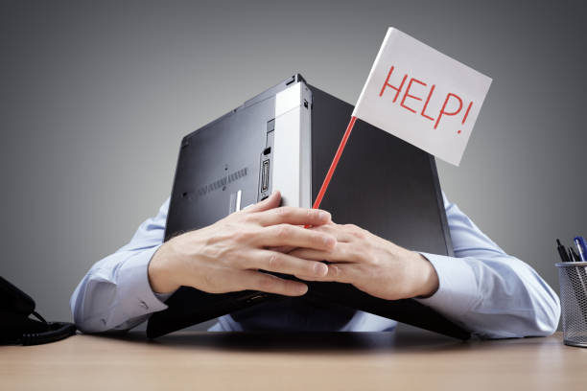
Job demands
Job analysis, occupational analysis
What do workers usually do to perform this job position?

Slide 7

Job profile
The assessment and analysis of an individual's personal traits and characteristics as they relate to their suitability for specific roles or tasks within a work or organizational context.
Job orientation interview
Assessment

Slide 8
Profesiogramme
Profesiogramme is a document or tool used in human resources management to describe the profile or characteristics of a specific job or profession.
Detailed information about the duties, responsibilities, required skills, qualifications, and competencies associated with a particular job role.
Assess the match between an individual's skills and experiences and the demands of the position.

Slide 9
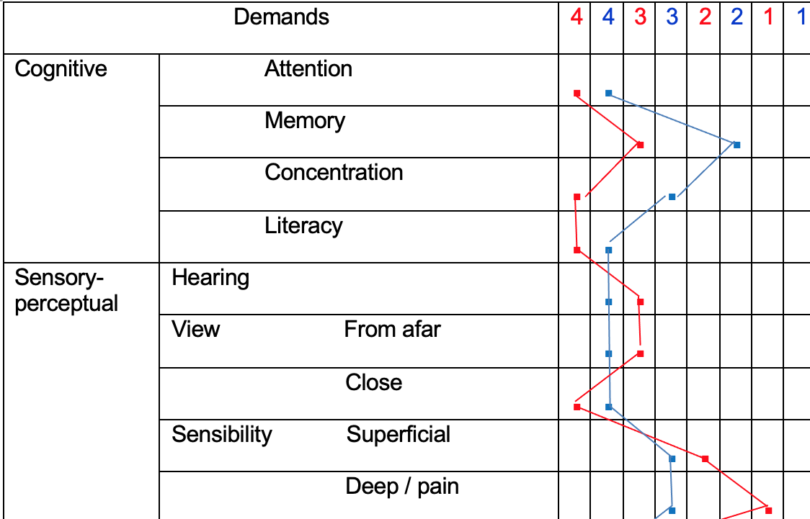
Profesiogramme
Profesiogramme is a document or tool used in human resources management to describe the profile or characteristics of a specific job or profession.
Detailed information about the duties, responsibilities, required skills, qualifications, and competencies associated with a particular job role.
Assess the match between an individual's skills and experiences and the demands of the position.
Job Details
Worker’s data

Slide 10
Performance Skills for Persons (AOTA, 2020)
Motor Skills—small, observable actions related to moving
oneself or moving and interacting with tangible task objects.
Positioning the body: Washing dishes at the kitchen sink
Stabilizes, Aligns, Positions
Obtaining and holding objects: Acquiring a game from a cabinet in preparation for a family activity
Reaches, Bends, Grips, Manipulates
Moving self and objects: Completing janitorial tasks at a factory site
Coordinates, Moves, Lifts, Walks, Transports, Calibrates, Flows
Sustaining performance: Bathing an older parent as caregiver
Endures, Paces

Slide 11
Process Skills are the group of performance skills that represent small, observable actions related to selecting, interacting with, and using tangible task objects; carrying out individual actions and steps; and preventing problems of occupational performance from occurring or reoccurring in the context of performing a personally and ecologically relevant daily life task.
Sustaining performance: Writing sentences for a school assignment
Paces, Attends, Heeds
Applying knowledge: Taking prescribed medications
Chooses, Uses, Handles, Inquires
Organizing timing: Using an ATM to get cash to pay a babysitter
Initiates, Continues, Sequences, Terminates
Organizing space and objects: Managing clerical duties for a large company
Searches/locates, Gathers, Organizes, Restores, Navigates
Adapting performance: Preparing a green salad for a family meal
Notices, responds, adjusts, accommodates, benefits

Slide 12
Social Interaction Skills are the group of performance skills that represent small, observable actions related to communicating and interacting with others in the context of engaging in a personally and ecologically relevant daily life task performance that involves social interaction with others.
Initiating and terminating social interaction: Participating in a community support group
Approaches/starts, concludes/disengages
Producing social interaction: Child playing in the sandbox with others to build roads for cars and trucks
Produces speech, Gesticulates, Speaks fluently
Physically supporting social interaction: Older adult in a senior residence talking with other residents during a shared mealtime
Turns toward, Looks, Places self, Touches, Regulates

Slide 13
Social Interaction Skills
Shaping content of social interaction: Serving ice cream to customers in an ice cream shop
Questions, Replies, Discloses, Expresses emotions, Disagrees, Thanks
Maintaining flow of social interaction: Sharing suggestions with others in a support group for persons experiencing mental health challenges
Transitions, Times response, Times duration, Takes turns
Verbally supporting social interaction: Visiting a Social Security office to obtain information relative to potential benefits
Matches language, Clarifies, Acknowledges and encourages, Empathizes
Adapting social interaction: Deciding which restaurant to go to with a group of friends
Heeds, Accommodates, Benefits

Slide 14
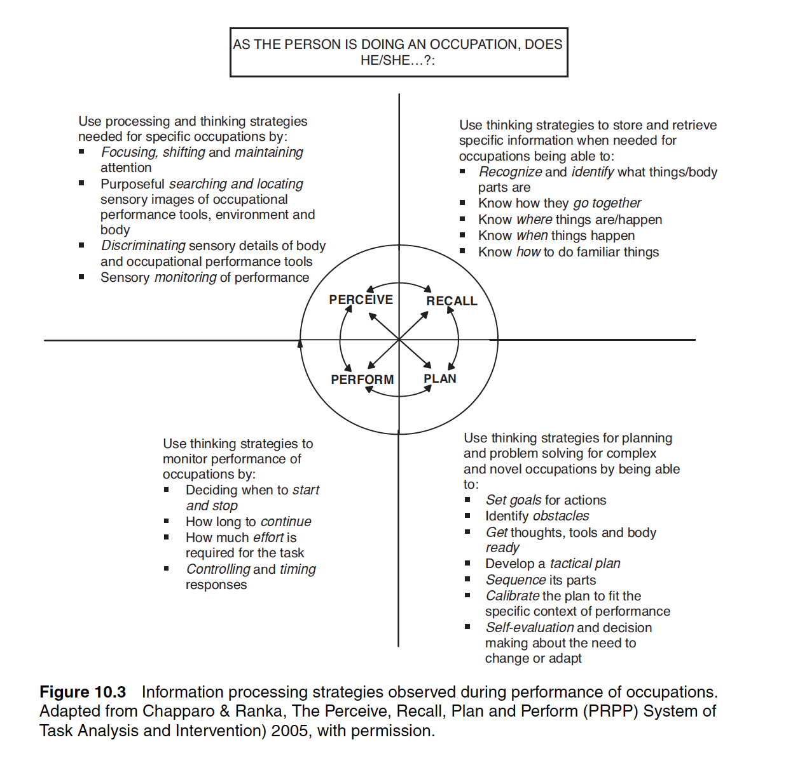
Complexity!
Example: cognition and
acquired brain impairment

Slide 15
Job profile
Analysis of performance
Synthesis of Evaluation Process
3) Work habits
3.1) Compliance with orders
3.2) Professional gesture
3.3) Order
3.4) Pace
3.5) Persistence
3.6) Interest in work
3.7) Organization
3.8) Accuracy
3.9) Efficiency
3.10) Responsibility
3.11) Productivity
3.12) Security
Average:
4) Technical-operational knowledge (example)
4.1) Assembling bags of fractionated feed
4.2) Replenishment of pet shop products
4.3) Cleaning of furniture
Average:
VARIABLES TO BE ASSESSED
1) General characteristics
1.1) Presentation and appearance
1.2) Assistance
1.3) Punctuality
1.4) Communication
1.5) Motivation to work
1.6) Customer satisfaction
Average:
2) Personal characteristics
2.1) Speed of decision
2.2) Stability and self-monitoring
2.3) Self-confidence
2.4) Tact and interaction skills
2.5) Self-direction and self-determination
2.6) Acceptance and supervision
2.7) Analysis and problem-solving
Average:

Slide 16
Evaluations
Canadian Occupational Performance (COPM; Law et al, 1998)
Occupational Performance History Interview (OPHI II; Kielhofner et al, 1998)
Assessment of Occupational Functioning (AOF; Watts et al, 1986)
Occupational Self-Assessment (OSA; Kielhofner, 2006)
Assessment of Motor and Process Skills (AMPS; Fisher, 1995)
Role Checklist (Okeley, Kielhofner, & Barris, 1985)
Rosenberg Self-Esteem Inventory
Volitional Questionnaire (de las Heras, 1998)
Coping Responses Inventory (CRI)
Wallston’s Personal Competence Scale
Internal/ External Locus of Control Scale (Rotter, 1966)
Work Environment Impact Scale (WEIS; Moore, 1998)
Worker’s Role Interview (WRI; Braveman et al., 1998)

Slide 17
Selection of the models
Specific to discipline, profession
Example, Occupational Therapy models-
Model of Human Occupation
Canadian Model of Occupational Performance and Engagement

Slide 18
Frames of references
Community participation
Community-based approaches
Person-centered approach
Motivational interviewing
Cognitive-behavioral approach
Acceptance and Commitment Therapy
Biomechanic approach
Cognitive Stimulation
The Allen's Cognitive Disabilities Model (CDM)
Sensory Integration
And other frames of references derived from other disciplines

Slide 19
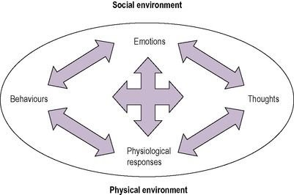
Cognitive-behavioral approach
CBT takes a problem-centred perspective on life difficulties and focuses on five aspects of life experience
thoughts
behaviours
emotion/mood
physiological responses
environment (Greenberger & Padesky, 1995).
Fig. 1 The influence of the social and physical environment on aspects of life experience (Reed, K. in Duncan, 2011)

Slide 20
Essential positions
Cognition levels
Cognitive therapy emphasises rapid and automatic interpretations of events and the importance of underlying beliefs and values.
Behavioural therapy emphasises our learned automatic responses to stimuli and how our behaviour is shaped by their consequences.
Automatic thoughts:
Automatic thoughts are common and plausible.
Beliefs:
These are conditional beliefs we have about ourselves.
Basic schemas:
Schemas are the most stable of the three cognitive constructs.
Core schemas develop beliefs, and from beliefs arise our automatic thoughts.

Slide 21
Automatic thoughts
Beliefs
Basic schemas
Direct question: What is (was) going through your mind at the moment?
Inductive questioning. Use a series of open-ended questions and reflective statements to help the client recall an emotional situation (e.g. what happened next? What did you do?).
Re-enactment of a situation. Using imagery, role play, and in vivo experiments.
Recording thoughts. Using thought journals, etc.
Overgeneralisation
Making general judgments based on isolated cases. "Everything I do goes wrong".
Selective abstraction
Focusing only on the negative aspects of the experience. "Nothing good happened today.
Dichotomous reasoning
Thinking in extremes, also known as black-and-white thinking. "If I can't do it right, there's no point in doing it.
Personalisation
Taking responsibility for things that have little or nothing to do with oneself. 'I must have done something to offend you'.
Arbitrary influence
Concluding without sufficient evidence. This course is rubbish' (when you've just started it!).
Core schemas are not as immediately accessible as automatic thoughts or beliefs; however, through specialised CBT a client can become aware of these processes (Young, 1999).

Slide 22

Applied Behavior Analysis
ABC analysis (Antecedents, Behavior, Consequences)
Antecedents
Behaviour
Consequences
Academic skills
Adaptive skills

Slide 23
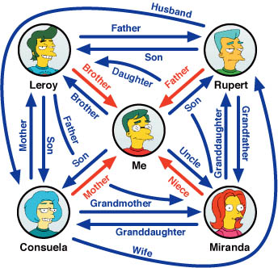
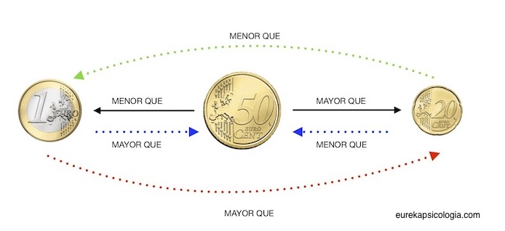
Contextual psychology or Third-Generation Therapies
Functional contextualism: it considers the behaviour of people in their context
Relational Frame Theory (RFT)
Acceptance and Commitment Therapy (ACT)
Revise: Steven Hayes publications

Slide 24
Evolution of Contextual-Behavioural Science
Functional Analysis
It is based on a pragmatic worldview known as functional contextualism.
It grows from behavioural analysis in its methodology and assumptions.
From basic behaviour to complex behaviours.
It aims to apply these advances in alleviating human suffering and advancing human wellbeing.
Allows for the identification of variables related to the behaviours
Create an explanatory hypothesis
Implement change by modifying the detected variables affecting the likelihood, incidence and prevalence of the behaviour.

Slide 25
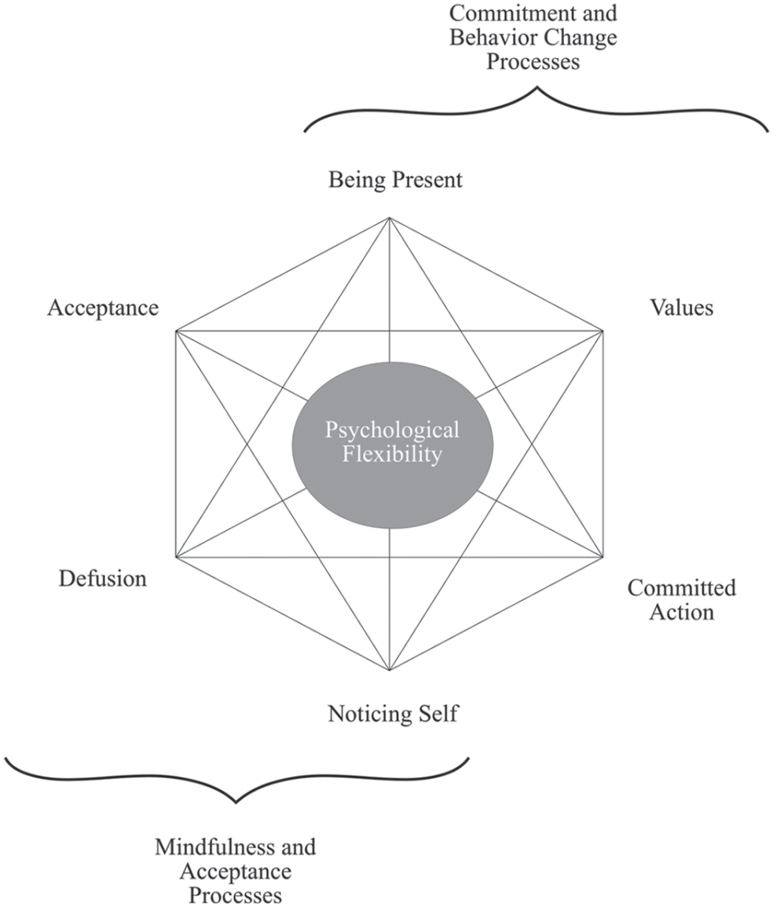
A model of behavioural change (ACT)

Slide 26
The Allen's Cognitive Disabilities Model (CDM) (Allen, 1992)
Automatic actions
Postural actions
Manual actions
Goal-directed actions
Exploratory actions, and
Planned actions
Task analysis and activity analysis:
Analysing each task to match the demands to the cognitive level of each client during an intervention.
Short-term goals aim to match the current mode of performance.
Long-term goals are based on a prediction of change in performance modes.
The ultimate goal of this model is to maintain the client’s existing skills and to develop new coping strategies.

Slide 27
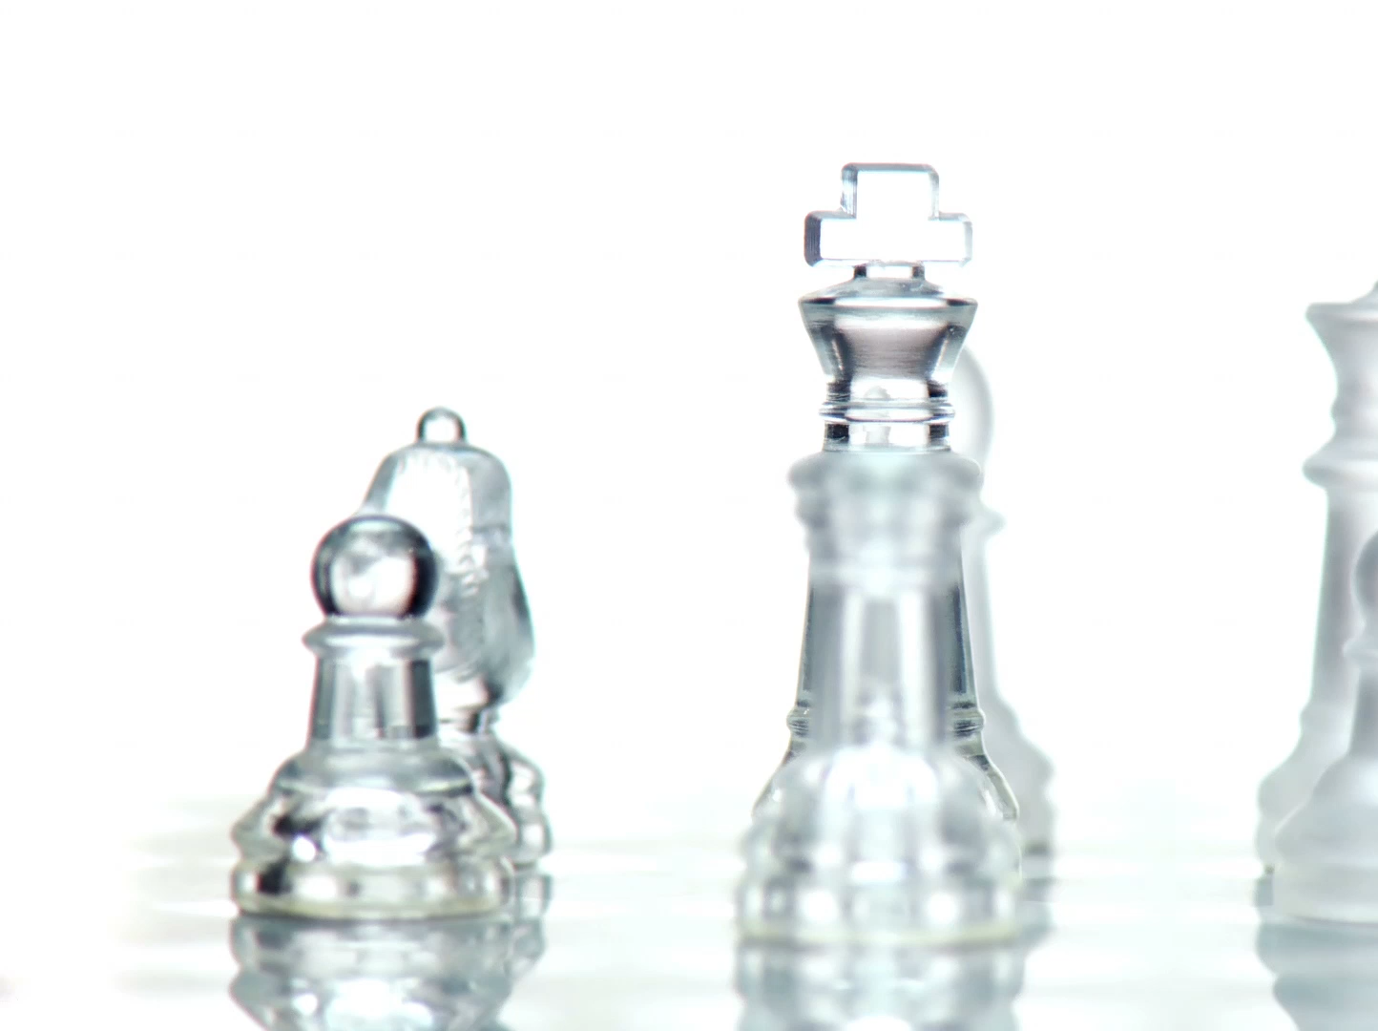
Strategies

Slide 28
Intervention types, approaches and strategies
Education and training
Advocacy
Self-advocacy
Group interventions
Virtual interventions
Create, promote (health promotion)
Establish, restore (remediation,
restoration)
Maintain
Modify (compensation, adaptation)
Prevent (disability prevention)

Slide 29
Allen, C. K. (1992). Cognitive disabilities. In N. Katz (Ed.), Cognitive rehabilitation: Models for intervention in occupational therapy (pp. 1-21). Stoneham: Butterworth-Heinemann.
American Occupational Therapy Association. (2020). Occupational therapy practice framework: Domain and process (4th ed.). American Journal of Occupational Therapy, 74(Suppl. 2), 7412410010. https://doi.org/10.5014/ajot.2020.74S2001
Heron R. (2005). Job and Work Analysis. Guidelines on Identifying Jobs for Persons with Disabilities. Geneva: International Labour Organization
Márquez Álvarez, L.J. (2023). Terapia Ocupacional i Inclusión laboral. Madrid: Editorial Síntesis.
Moruno P, Talavera MA, Lamy N, & Cantero P. (2012). Terapia Ocupacional en recursos para la integración sociolaboral. En Moruno P, Talavera MA. Terapia Ocupacional en Salud Mental. Barcelona: Elsevier MASSON.
Rothwell W.J., Jacqueline M. Stavros J.M., Sullivan R., Sullivan A. (eds.) (2009). Practicing Organization Development: A Guide for Leading Change. 3rd Edition. UK: Wiley

Slide 30
Thank you for your attention

Slide 31
PER A MÉS INFORMACIÓ
C/ de la Riba, 90
08221 Terrassa I BARCELONA
T. 93 783 77 77

