Slide 1





Qualitative Research in Health and Social Sciences
and the Focus Group Methodology
Maria Kapanadze Kapanadze, PhD
Research Professor
Occupational Therapy Department
Contributions: Núria Codern-Bové, PhD
Research Professor
Nursing Department
21/05/2025

Slide 2
Session Objectives
Review the characteristics of qualitative research
Identify different types of sampling in qualitative research
Describe techniques for generating data
Understand the focus group and its design

Slide 3
What is Qualitative Research?
Study phenomena in their natural context
Seeks meaning from participants' perspectives (Denzin & Lincoln, 2004)

Slide 4
Characteristics of Qualitative Research
Focus on people’s experiences and perceptions
Subjective data
Inductive approach
Open and flexible design

Slide 5
Data Collection in Qualitative Research
Includes observation, in-depth interviews, and focus groups
Sample aims for socio-structural representativeness
Results provide deep understanding from the participants’ view
Presented as themes, ethnographic descriptions, and concepts

Slide 6

Qualitative Research
Pe ople’s health condition experiences
Professional-client relationships
Health promotion and prevention habits
Influence of social and community contexts
Healthcare and social care professionals' experiences

Slide 7
Qualitative Research Process
Who? How?
Sampling characteristics
Representativeness based on discourse, not quantity

Slide 8
Sampling characteristics: participants
Socio-structural, theoretical, reasoned sampling
Cumulative, sequential
Flexible, reflective
The sample should be representative, aiming to reproduce, as much as possible at a micro level, the macro social structure. Select the participants who are best able to answer the research questions.
Include participants in the sample until the necessary information is obtained, up to the point of data saturation (when no new information emerges).
As the data is analysed, there may be a need to incorporate new aspects that were not initially considered.
The power of the sample does not depend on its size, but on the representativeness of the discourse.

Slide 9
Sampling Design Example
Study on diet beverage acceptance
Target: Women aged 15–70, various socioeconomic levels
Age ranges:
Adolescents (15–17)
Young Adults (18–30)
Adults (30–60)
Seniors (>60)

Slide 10
Inclusion and Exclusion Criteria
Inclusion: Women, all age groups, all social classes, willing to participate
Exclusion: Refusal to participate
To ensure that the sample is representative, inclusion criteria are combined to create theoretical profiles. Once the theoretical profiles are defined, the aim is to select them using sampling techniques (e.g., convenience sampling).

Slide 11
Sample Size and Saturation
Minimum: 12 profiles to reflect the social structure
Final size determined by data saturation—no new information emerges
Socioeconomic level | Age range
 | 13-17 | 18-30 | 30-60 | More then 60
Low | X (perfil 1) | X (perfil 4) | X (perfil 7) | X (perfil 10)
Midde | X (perfil 2) | X (perfil 5) | X (perfil 8) | X (perfil 11)
Upper | X (perfil 3) | X (perfil 6) | X (perfil 9) | X (perfil 12)

Slide 12
Case Study
Socio-structural, theoretical, reasoned sampling
Cumulative, sequential
Flexible, reflective
Objective: Explore the experiences of persons with learning disabilities involved in inclusive employment in Georgia.
Questions:
- What structural criteria define the sample (selection of participants)?
- What is the minimum sample size?

Slide 13
Sampling Strategy
As far as possible, individuals who meet the previously defined characteristics will be selected.
This is not always possible.
Intentional sampling
Based on accessibility and study relevance
Not generalisable
Used in exploratory or specific population studies
involving a population with very specific characteristics.

Slide 14
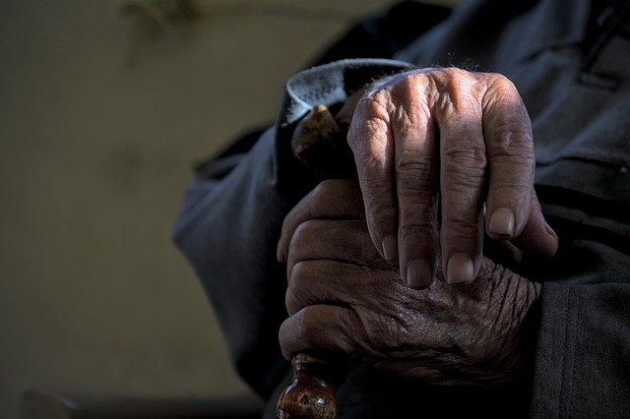
Data Generation Techniques
1. Contextual: Participant observation
2. Individual narrative: Qualitative interview, biographical method
3. Dialogic narrative: Focus groups, discussion groups

Slide 15

What is a Focus Group?
Group with shared characteristics
Generates narratives on a topic
Interaction is key: explore perspectives, recall forgotten details, foster openness

Slide 16
Use in Health Settings
Understand behaviours and norms
Explore commonalities and differences
Analyse how people speak: tone, nonverbal cues

Slide 17









Designing a Focus Group
Group size: 5–10 participants
Number of groups: 2–5 per stratum

Slide 18


Group Design
Homogeneity promotes shared narratives
Controlled heterogeneity reveals differing views
Avoid power imbalances
Consider known vs. unknown participants
Stratify by key characteristic

Slide 19
Example: Group Composition
Study on a vocational rehabilitation program
Participants: Persons with Learning Disabilities, caregivers, health and social care professionals
What characteristic will define the group composition?

Slide 20

Focus Group Procedure
Data recollection
Preparation of the focus group guide
Prepare 5–10 questions (5–10 min each)
Dynamic
Introduce participants
Explain study and criteria – define the objective and the question of the study
Explain dynamic rules
Conduct questions
Close and thank

Slide 21
Focus Group Guide
Develop a script tailored to the study’s topic and participants.

Slide 22
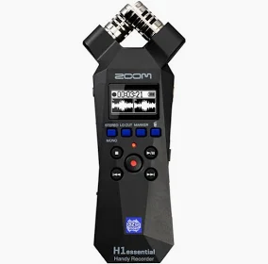
Materials Needed
Audio recorder
Consent forms
Pens, charts
Documents for moderator and observer

Slide 23
Other Considerations
Invitations, scheduling
Location of focus group
Appreciation gift—consider what and why

Slide 24
Moderator Skills
Simple language
Probing: 'What do you mean by...?'
Strong observation
Guide discussion, synthesise content
Avoid giving examples or personal opinions

Slide 25
Facilitation
What are we listening for?

Slide 26
Data Analysis
Similar to interview analysis
Group code? is the unit of analysis
Identify themes and contrasting views
Volume ≠ importance

Slide 27
Focus Group Design Exercise
Objective: Examine students' perceptions of their learning process, with a particular emphasis on professional reasoning, and experiences of involvement in the Project Labs for Equal Rights.
Define structural criteria, number of groups, recruitment strategy, location, and question guide.

Slide 29
PHOTOVOICE Methodology

Slide 30
What is Photovoice?
A participatory action research (PAR) method using photography
Participants capture photos representing their experiences
Promotes empowerment, reflection, and knowledge-sharing
Especially effective for populations in underrepresented conditions

Slide 31
Why Use Photovoice with Individuals with Intellectual Disabilities (ID)?
Traditional methods (e.g., interviews, surveys) often fail to capture their perspectives
Photovoice bypasses communication and cognitive barriers
Visual data allows deeper insight into lived experiences
Encourages autonomy and self-expression

Slide 32
Steps of Photovoice within PAR Framework
1. Recruitment and Orientation
Participants are invited to join and are introduced to the project aims.
Training in photography and ethical considerations.
2. Photo-taking Phase
Participants take photos that reflect their daily lives and key experiences.
3. Discussion and Reflection
Group or individual discussions about the meaning of selected photos.
Themes begin to emerge collaboratively.
4. Analysis and Theming
Participants and researchers analyse images to identify shared themes and insights.
5. Action and Dissemination
Results are shared through exhibitions, reports, or community forums.
Aim to influence policy, raise awareness, and promote inclusion.

Slide 33
References
Alonso, L. E. (1998). La mirada cualitativa en sociología: Una aproximación interpretativa (2nd ed.). Madrid: Fundamentos.
Callejo Gallego, J. (2002). Observación, entrevista y grupos de discusión: El silencio de tres prácticas de investigación. Revista Española de Salud Pública, 76(5), 409–422.
Denzin, N. K., & Lincoln, Y. S. (Eds.). (2004). The SAGE handbook of qualitative research (3rd ed.). Thousand Oaks, CA: SAGE Publications.
Iñiguez Rueda, L. (2008). Tipologías de estrategias de muestreo. In J. M. Delgado & J. Gutiérrez (Eds.), Métodos y técnicas cualitativas de investigación en ciencias sociales. Madrid: Síntesis.
Kuper, A., Lingard, L., & Levinson, W. (2008). Critically appraising qualitative research. BMJ, 337, a1035. https://doi.org/10.1136/bmj.a1035
Morse, J. M. (1999). Qualitative methods: The state of the art. Qualitative Health Research, 9(3), 393–406. https://doi.org/10.1177/104973299129122003

Slide 34
Thank you for your attention

Slide 35
PER A MÉS INFORMACIÓ
C/ de la Riba, 90
08221 Terrassa I BARCELONA
T. 93 783 77 77

