Slide 1





Person-centred outcome measures’ use in Vocational Rehabilitation
Example: Canadian Occupational Performance Measure (COPM)
Maria Kapanadze Kapanadze, PhD
Research Professor
Contribution: Elisabet Capdevila, PhD
Research Professor
Occupational Therapy Department
20/05/2025

Slide 2

Introduction to the COPM
The Canadian Occupational Performance Measure (COPM) is a client-centred outcome measure.
Semi-structured interview format and structured scoring.
Designed to detect change in a client’s self-perception of occupational performance over time.
Measures performance and satisfaction in self-care, productivity, and leisure.
Used across all ages and types of disability.

Slide 3
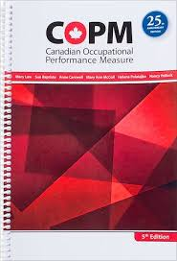
Based on the OT model
Designed to perform Client-Centred Practice
Therapists as enablers/trainers/facilitators
Clients are responsible and collaborators in the treatment
Based on OT expertise and occupation-based client-centred practice

Slide 4
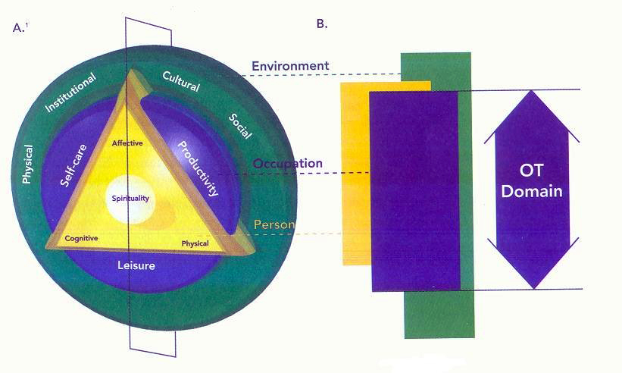
COPM Conceptual Framework
Based on the Canadian Model of Occupational Performance and Engagement (CMOP-E)
The model concerns the potential and possible occupational engagement afforded by the person-occupation-environment interaction. It goes beyond performance.

Slide 5

COPM Conceptual Framework
Central to the model: spirituality, surrounded by affective, physical, and cognitive components.
"Enabling a just and inclusive society so that all people may participate to their potential in the daily occupations of life" (Townsend & Polatajko, 2007)

Slide 6
Characteristics
Applicable to all ages and developmental levels.
Can be used in groups.
It is administered initially and periodically throughout the intervention according to the client's and therapist's needs.
Considers client satisfaction with current performance.
Incorporates client roles and role expectations.
Incorporates reassessment.
Allows for input from members of the social environment (when the client cannot).

Slide 7
COPM Administration Process
Administered by the occupational therapist with the client, identifying occupational performance issues.
Broad focus on performance and engagement in all areas of life, including self-care, leisure and productivity, considering personal circumstances and life history.
COPM is administered through a 15- 30-minute semi-structured interview that allows for an open dialogue between the client and therapist about issues relevant to the person.

Slide 8
COPM Administration Process
It initiates a conversation with the client about daily life performance problems and provides the basis for designing intervention goals.
During the intervention, it is used to assess changes in occupational performance.
Once the desired change in performance is achieved, the therapist and client decide whether to identify new occupational problems or to finalise the intervention.

Slide 9

COPM Administration Process
The Interview. It is important to briefly introduce occupational therapy and the measures to help the client understand the COPM.
Step 1: Problem definition. Identify occupational performance issues.
There are a variety of ways to help clients in this thinking process.
Step 2: Rating Importance. Rate the importance of each issue (1–10 scale).

Slide 10
COPM Administration Process
Step 3: Selecting Problems for Score. Select up to 5 issues.
•Using the information and ratings of the occupational problems recorded above, the five most important problems for the client are selected.
Step 4: Scoring Performance and Satisfaction. Rate performance and satisfaction, each rated out of 10.
For each problem, the client is asked to complete the following ten-point scales, on which they should rate how they currently perform the activity (performance) and how satisfied they are with it (satisfaction).

Slide 11
Step 5: Client Reassessment. Re-evaluate after intervention to measure change.
A re-evaluation is performed after some time and after having carried out the therapeutic intervention.
Scores concerning performance and satisfaction are reviewed again.

Slide 12
Scoring Process
Up to 5 individual occupational performance problems are identified.
Average PERFORMANCE and SATISFACTION scores are calculated.
Change scores are computed between Time 1 (assessment) and Time 2 (reassessment).
Scores are not comparable between individuals — only within the same person.

Slide 13
COPM and Vocational Rehabilitation (VR)

Slide 14
Identification and measuring vocational rehabilitation outcomes
The COPM provides a structured, individualised approach to identifying and measuring vocational rehabilitation outcomes.
Flexibility and sensitivity to client priorities:
complex return-to-work contexts involving physical, cognitive, or psychosocial challenges.

Slide 15

Using the COPM in Multidisciplinary Teams of VR:
Occupational therapists, psychologists and social workers
The use of the COPM as a tool in teamwork.
Development of the team-based goals.
The goals are negotiated and understood by clients.

Slide 16

COPM permits:
1. Identify meaningful vocational goals (Verhoef et al., 2013).
Clients are guided to define and prioritise work-related performance problems (e.g., fatigue during tasks, difficulties in organisation, communication at work). These physical, cognitive, or psychosocial barriers may interfere with employment.

Slide 17

2. Track changes over time
The COPM measures perceived changes in occupational performance and satisfaction, allowing professionals and clients to assess the effectiveness of vocational interventions, such as job coaching, workplace adaptations, or psychosocial support.

Slide 18

3. Enhance client engagement
What matters most to the client, the COPM supports motivation, ownership, and active participation in return-to-work planning.

Slide 19
COPM in VR includes explicitly:
Discussion of work topics
Discussion of work topics: searching for work, job interviews, work environments, etc.
Specific occupational performance problems include finding a particular job, developing organisational skills, and increasing technology skills.
Perceived improvements: time management, physical capacity, and emotional regulation at work, among others.

Slide 20
COPM administration in VR
Initial assessment to identify barriers to work and set goals.
Assess change in performance and satisfaction.
These phases are often paired with functional capacity evaluations, environmental assessments, or psychological tools to build a comprehensive intervention plan.

Slide 21
Client Profile
Name: Alex
Age: 28
Diagnosis: Learning Disability (LD), primarily affecting reading comprehension, written expression, and executive functioning
Context: Enrolled in a 6-month vocational rehabilitation program aiming to support entry into competitive employment
Setting: Community-based rehabilitation centre
Interview conducted by: Occupational Therapist

Slide 22
Step 1: Identifying Occupational Performance Issues
The occupational therapist (OT) uses open-ended questions to support Alex in identifying daily activities he wants or needs to do but currently finds difficult or unsatisfactory. These span across productivity, self-care, and leisure domains.

Slide 23
Reported Occupational Performance Problems
Productivity
Finding a suitable job: Difficulty identifying roles aligned with his strengths; limited knowledge of job platforms.
Preparing for job interviews: Experiences anxiety and struggles to organise responses.
Adapting to work environments: Difficulty processing verbal instructions in noisy settings.
Using workplace technology: Needs support from email, spreadsheets, and scheduling tools.
Time management and organisation: Trouble prioritising tasks and maintaining order.

Slide 24
Self-Care
Morning routine: Struggles with time awareness and transitioning from home to work activities.
Meal preparation and nutrition: Reports irregular meals and skipping breakfast before training sessions.
Leisure
Social engagement: Avoids social activities due to low confidence in communication.
Recreational technology use: Feels excluded from peer groups due to lack of digital literacy (e.g., using apps, games, social platforms).

Slide 25
Step 2: Scoring Importance
Step 3: Selecting Priority Problems
Step 4: Scoring Performance and Satisfaction

Slide 26
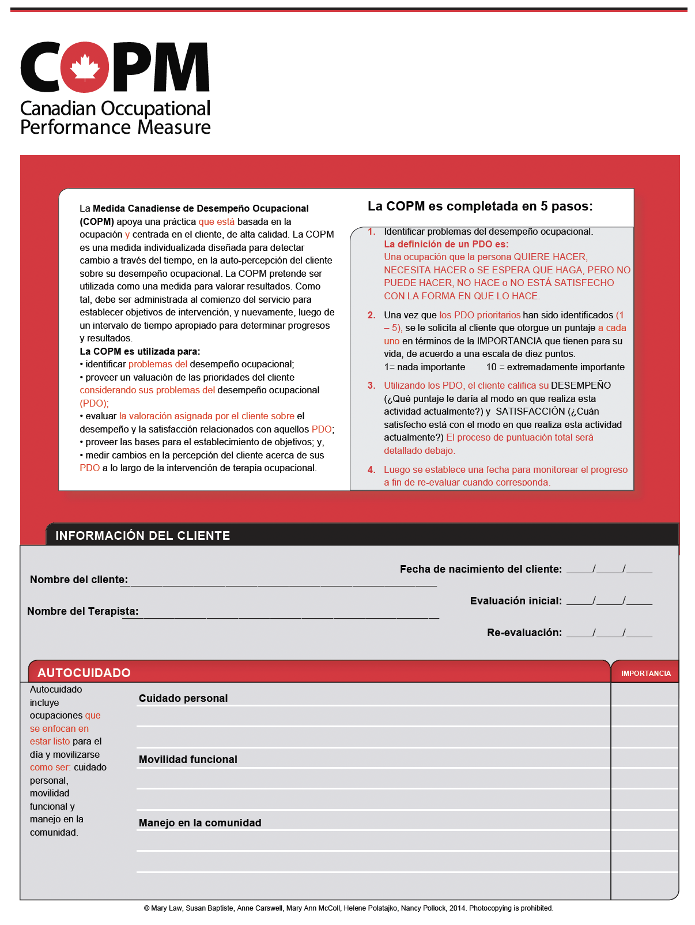
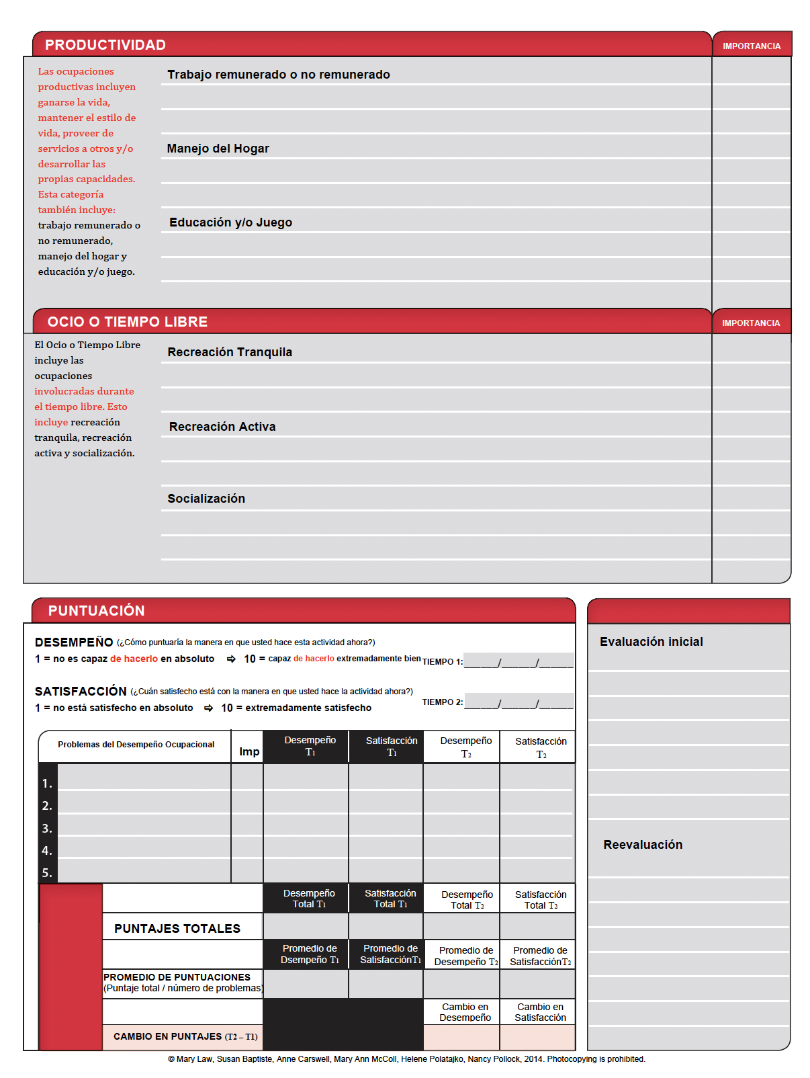
Finding a suitable job
preparing for job interviews
9
7
7
8
9
Adapting to work environments
Using workplace technology
Time management and organization
Recreational technology use
8
Social engagement
6
Alex
12 01 23
12 03 23
12 01 23
12 03 23
Morning routine
Meal preparation and nutrition
8
7
Finding a suitable job
Time management
Organisational skills
Using workplace technology
Morning routine
9
9
8
8
7
2
3
2
1
5 4
6
7
6
6
7 7

Slide 27
Step 5: Setting Goals & Monitoring Change
The OT and Alex collaboratively define goals based on COPM findings:
Explore job roles using visual supports.
Establish daily planners and digital reminders.
Develop routines for timely transitions.
Practice using email and calendar autonomously.
Build self-efficacy in job interviews through role-playing.

Slide 28
Reassessment and Outcomes
After 8 weeks, Alex is reassessed. Notable improvements include:
Time management – Performance: 7, Satisfaction: 7
Organisational skills – Performance: 6, Satisfaction: 6
Technology use – Performance: 5, Satisfaction: 6
Job search – Performance: 6, Satisfaction: 6
Morning routine – Performance: 7, Satisfaction: 7
Additional Gains (Self-Reported)
Improved emotional regulation at work
Greater physical capacity for work tasks
Increased social participation in peer activities

Slide 29
COPM and Research

Slide 30
Psychometric Properties and Instrument Characteristics
The COPM is a standardised measure with specific administration and scoring guidelines.
It is not norm-referenced: it does not compare individuals to a population norm.
Occupational performance is conceptualised as a subjective, individual experience.

Slide 31
Validation Outcomes
COPM has been validated in diverse samples, countries, and settings +40 studies (COPM, 2024).
Mental Health, Learning Disability, Rehabilitation, Geriatrics, Paediatrics, etc.
Proven reliability, validity, clinical utility, and responsiveness to change.
Continues to be the subject of international research and refinement.

Slide 32
Validation Outcomes
Reliability: Internal consistency, good test-retest reliability (ICC up to .89 for satisfaction).
Validity: Supported by content, construct (convergence, divergence, discrimination), criterion-related studies, and predictive.
Sensitivity: Detects clinically essential changes over time.
Utility: Adequate, acceptable (professionals, population, society), practicable, accessible.

Slide 33
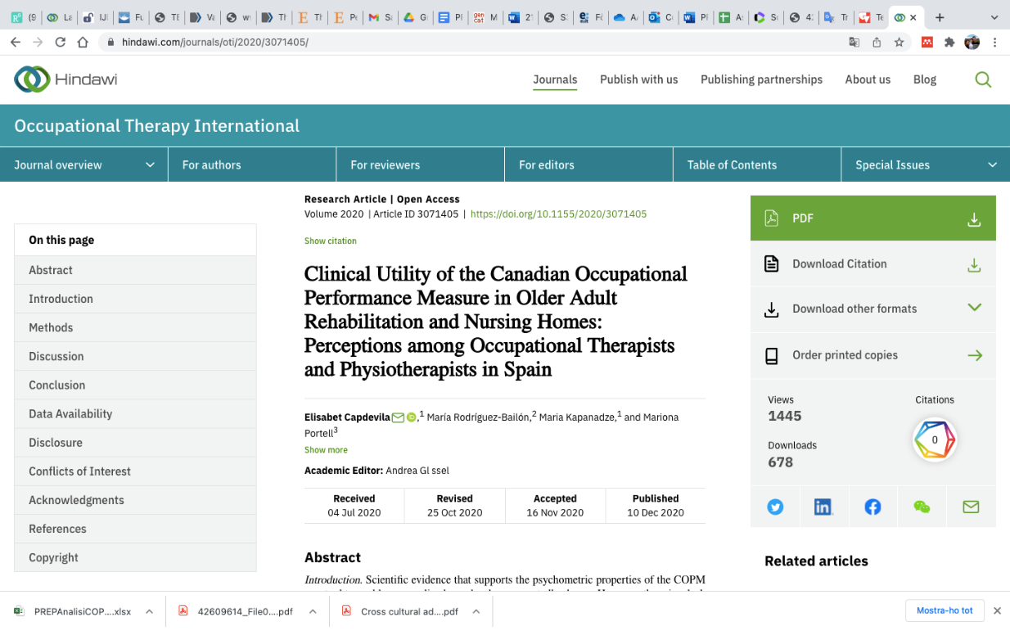

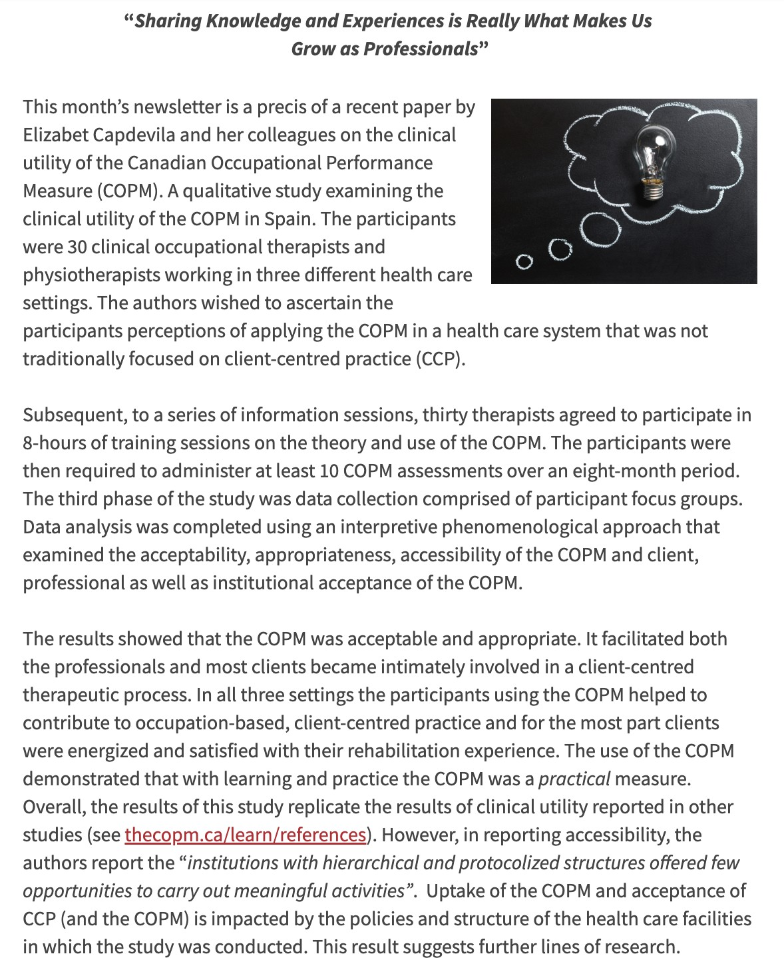
Clinical Utility and Feedback
Therapists report usefulness in initial assessment and goal setting.
Clients feel engaged in the therapy process.
Applicable in community and. mental health settings.
Challenges include time and cognitive load for some clients.

Slide 34
Utility
Appropriateness and acceptability for population, professionals, institutions:
Benefits and limitations perceived by clients, families, professionals, and institutions.
Practicable: administration process (time, place...), learning process of the instrument application (training), adaptation to the team...
Accessible: necessary resources to use the measure (personnel, materials, infrastructure, time...) (Smart, 2006).

Slide 35
Reflections on key aspects of the concept of clinical utility
Write and visualise essential topics to facilitate thematic follow-up throughout the session.
Moderate open discussions and interactive dialogues, emphasising the importance of individual opinions.
(1) consideration of the pros and cons of using the instrument (acceptable and appropriate components),
(2) the learning process during implementation (practicable component), and
(3) future expectations (accessible component).

Slide 36
Interpretative Phenomenological Analysis (IPA)
1) Reading and rereading the transcribed text (emerging codes and subcodes);
2) Identifying and labelling topics and grouping them into clusters (categories);
3) Introduction of the structure to the analysis using the Smart conceptual framework.
The subsequent coding and subcoding process was iterative.
Furthermore, these codes, subcodes, and themes were categorised according to Smart's conceptualisation.

Slide 37
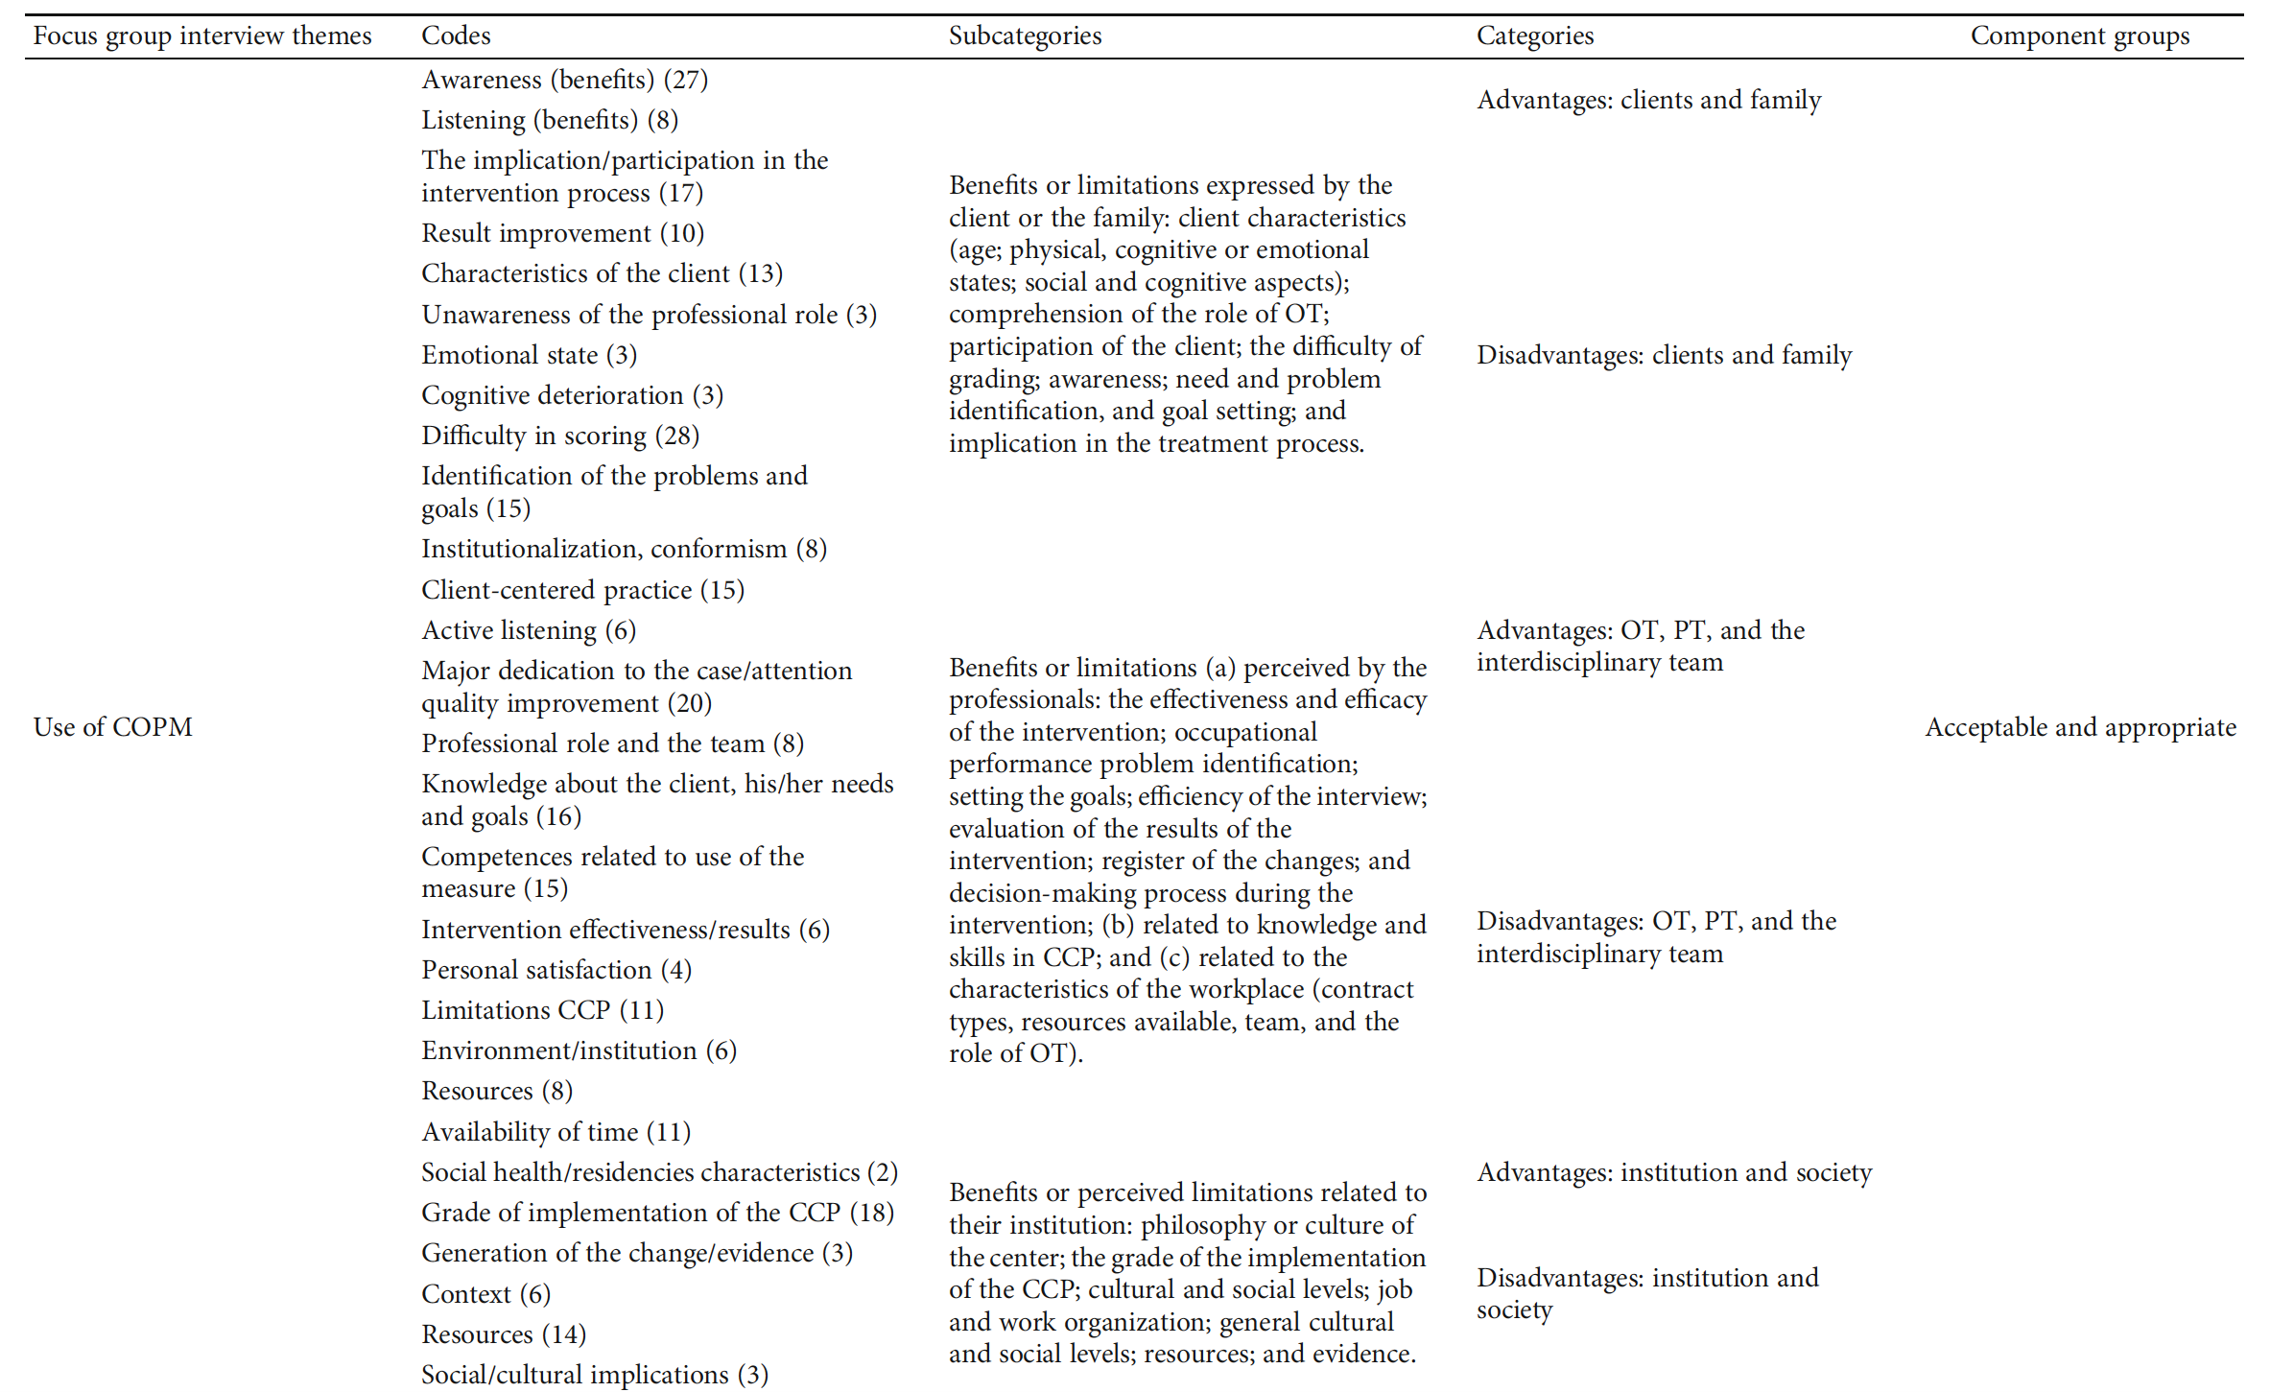

Slide 38
Summary and Implications
COPM supports client-centred practice by prioritising what matters to the client.
Encourages shared decision-making and personalised care.
Widely validated and translated internationally.

Slide 39
References
Law, M., Baptiste, S., Carswell, A., McColl, M. A., Polatajko, H. J., & Pollock, N. (1991). Canadian Occupational Performance Measure Manual (1st edition ed.). Ottawa: CAOT Publications.
Law, M., Baptiste, S., McColl, M., Opzoomer, A., Polatajko, H., & Pollock, N. (1990). The Canadian occupational performance measure: an outcome measure for occupational therapy. Canadian Journal of Occupational Therapy, 57(2), 82-87. https://doi.org/10.1177/000841749005700207
Smart, A. (2006). A multi-dimensional model of clinical utility. International Journal for Quality in Health Care : Journal of the International Society for Quality in Health Care / ISQua, 18(5), 377–382. http://doi.org/10.1093/intqhc/mzl034
Švajger, A., & Piškur, B. (2016). The clinical utility of the Canadian Occupational Performance Measure in vocational rehabilitation: a qualitative study among occupational therapists in Slovenia. Work, 54(1), 223-233. https://doi.org/10.3233/WOR-1622
Townsend, E., & Polatajko, H. (2007). Enabling Occupation II: Advancing an Occupational Therapy Vision for Health, Well-being & Justice through Occupation. Ottawa: CAOT ACE.
Verhoef, J. A., Miedema, H. S., Meeteren, J., Stam, H. J., & Roebroeck, M. E. (2013a). A new intervention to improve work participation of young adults with physical disabilities: a feasibility study. Developmental Medicine & Child Neurology, 55(8), 722-728. https://doi.org/10.1111/dmcn.12158
Verhoef, J. A., Roebroeck, M. E., van Schaardenburgh, N., Floothuis, M. C., & Miedema, H. S. (2013b). Improved Occupational Performance of Young Adults with a Physical Disability After a Vocational Rehabilitation Intervention. Journal of Occupational Rehabilitation, 1-10. https://doi.org/10.1007/s10926-013-9446-9
Wressle, E., Lindstrand, J., Neher, M., Marcusson, J., & Henriksson, C. (2003). The Canadian Occupational Performance Measure as an outcome measure and team tool in a day treatment programme. Disability & Rehabilitation, 25(10), 497-506. https://doi.org/10.1080/0963828031000090560

Slide 40

Thank you for your attention

Slide 41
PER A MÉS INFORMACIÓ
C/ de la Riba, 90
08221 Terrassa I BARCELONA
T. 93 783 77 77

