Slide 1
Project Director : Professor Ketevan Makashvili ISU Project Coordinator: Professor Shorena Sadzaglishvili GSU Project Coordinator: Zurab zurabashvili
GRANT #CIF-2023-04
Learning Labs for Equal Rights
09.2023 - 02.2025

Slide 2
INTERNATIONAL FRAMEWORK: General Principles of the Equal Rights for Adolescents with Limited Abilities;
Inclusion;
Person–Centered Approaches;
Natural Supports;
Student and Family Empowerment;
Student Choice;
Self- Determination.
IDEA 04
The Individuals with Disabilities Education Act (IDEA 04) requires that when the student turns 16 years of age his annual IEP must include a discussion about transition service needs.

Slide 3
Systematic Approach to Employment People with special needs and People /persons with disabilities
Georgian Context
EU supported employment tool
Ministry of Education and Science
Ministry of Labour, Health and Social Security
Intermediary service between vocational schools
and places of employment
Employment coordinator position
Employment consultant position

Slide 4
PROJECT AIMS
Create a multidisciplinary/multi-professional learning practical laboratories (hubs) in two universities of Georgia for promotion of PWDs social integration and involvement in the supportive community;
Promote employment in the higher education system for PWDs
Practice placement for psychology and social work students
Analysis of various jobs for persons with disabilities and determination of specific work-related skills for PWDs
Internationalization – competence development among university staff and students – international training
Updated syllabuses, improved learning and teaching processes – innovative teaching
Develop a continuous education program for service managers and providers who are interested in employing 18+ PWDs
Develop Integrative Research Center for psychologists and social workers will be created to offer practice for social work and psychology students.
Develop network of relevant organizations and stakeholders for improvement of social integration of PWDs through modern technologies

Slide 5
International Collaboration
PARTNERS
Rudolf Steiner University College
Department of Occupational Therapy, University School of Nursing and Occupational Therapy of Terrassa, Autonomous University of Barcelona (EUIT-UAB).
UVic-UCC (Center for sanitary and social studies at UVic-UCC)Universitat de Vic - Universitat Central de Catalunya Vic, Spain

Slide 6
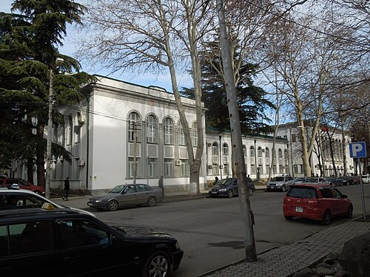


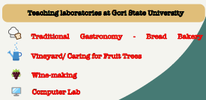

Slide 7



PWDs – in protected Environment /Job Candidate
Job Coach
Students (Psychology/Social Work)
Craft Teacher
Supervisors/Researchers – Psychology and Social Work
Laboratory Staff

Slide 8
The Main Principals of Work
Trinal Method (theory, practice, art)
Place and Train
Notes:
The "place and train" method involves placing individuals with disabilities directly into workplace environments where they receive on-the-job training and support. Rather than traditional classroom-based training programs, this approach emphasizes experiential learning within authentic work settings. Trainers and supervisors work closely with participants to teach job tasks, provide feedback, and gradually increase independence until the individual can perform the job duties competently (Lombardi & Nardone, 2011).

Slide 9
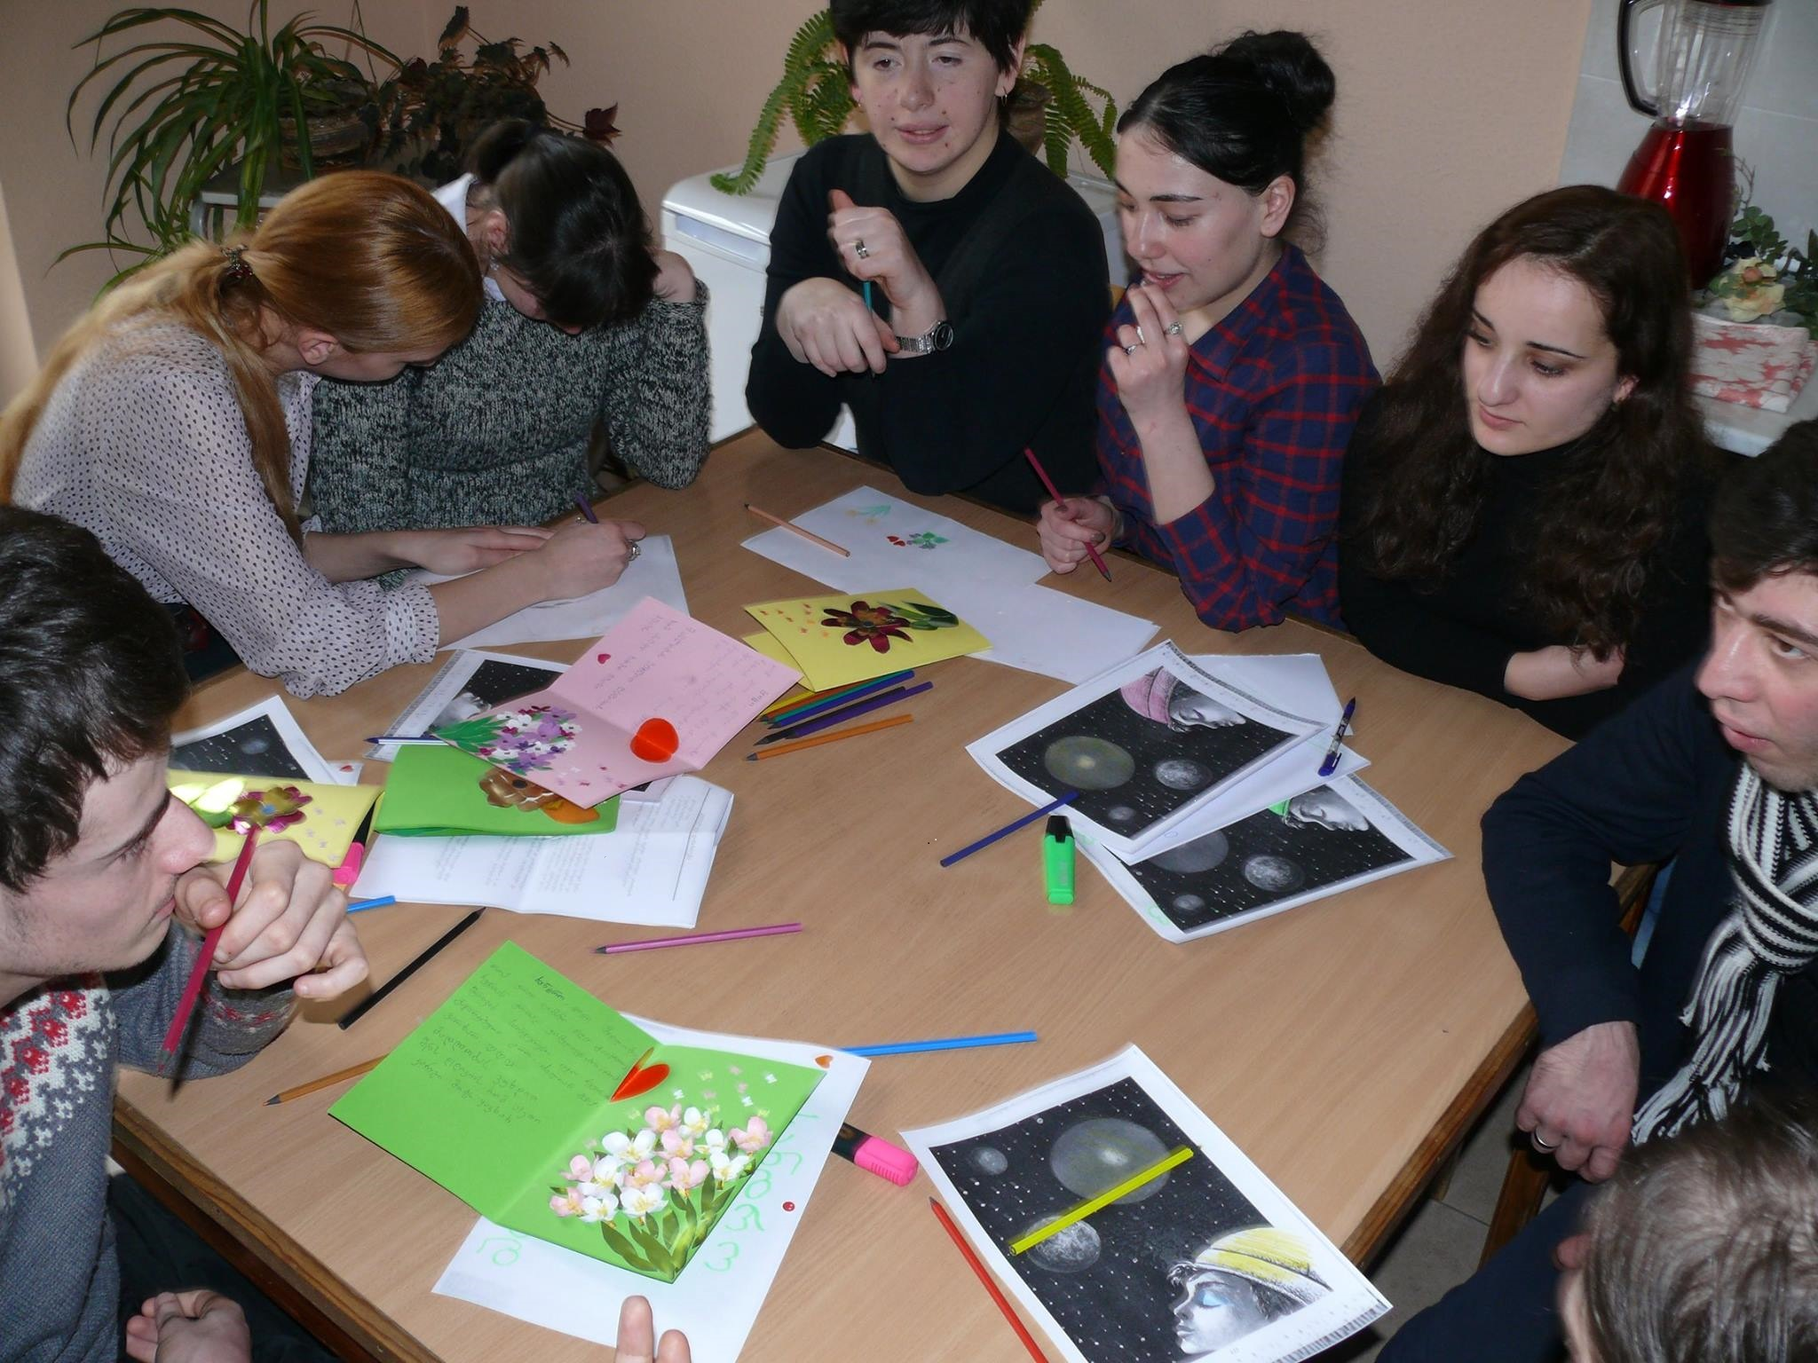

Innovative Teaching and Learning
Project Based Learning
Multi disciplinary
Group Work
Notes:
9

Slide 10
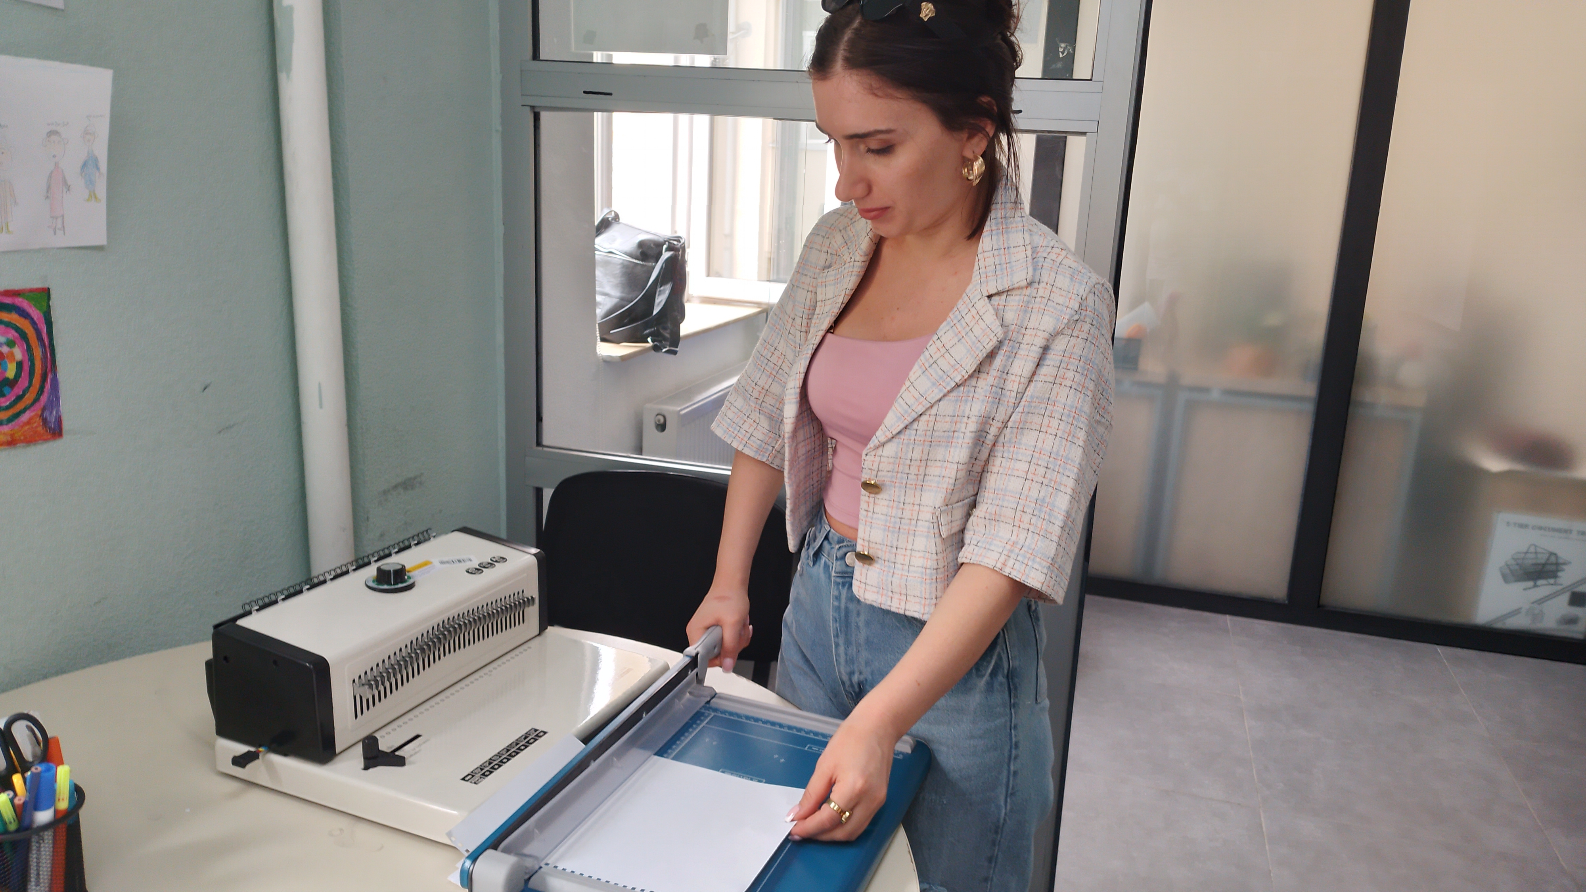

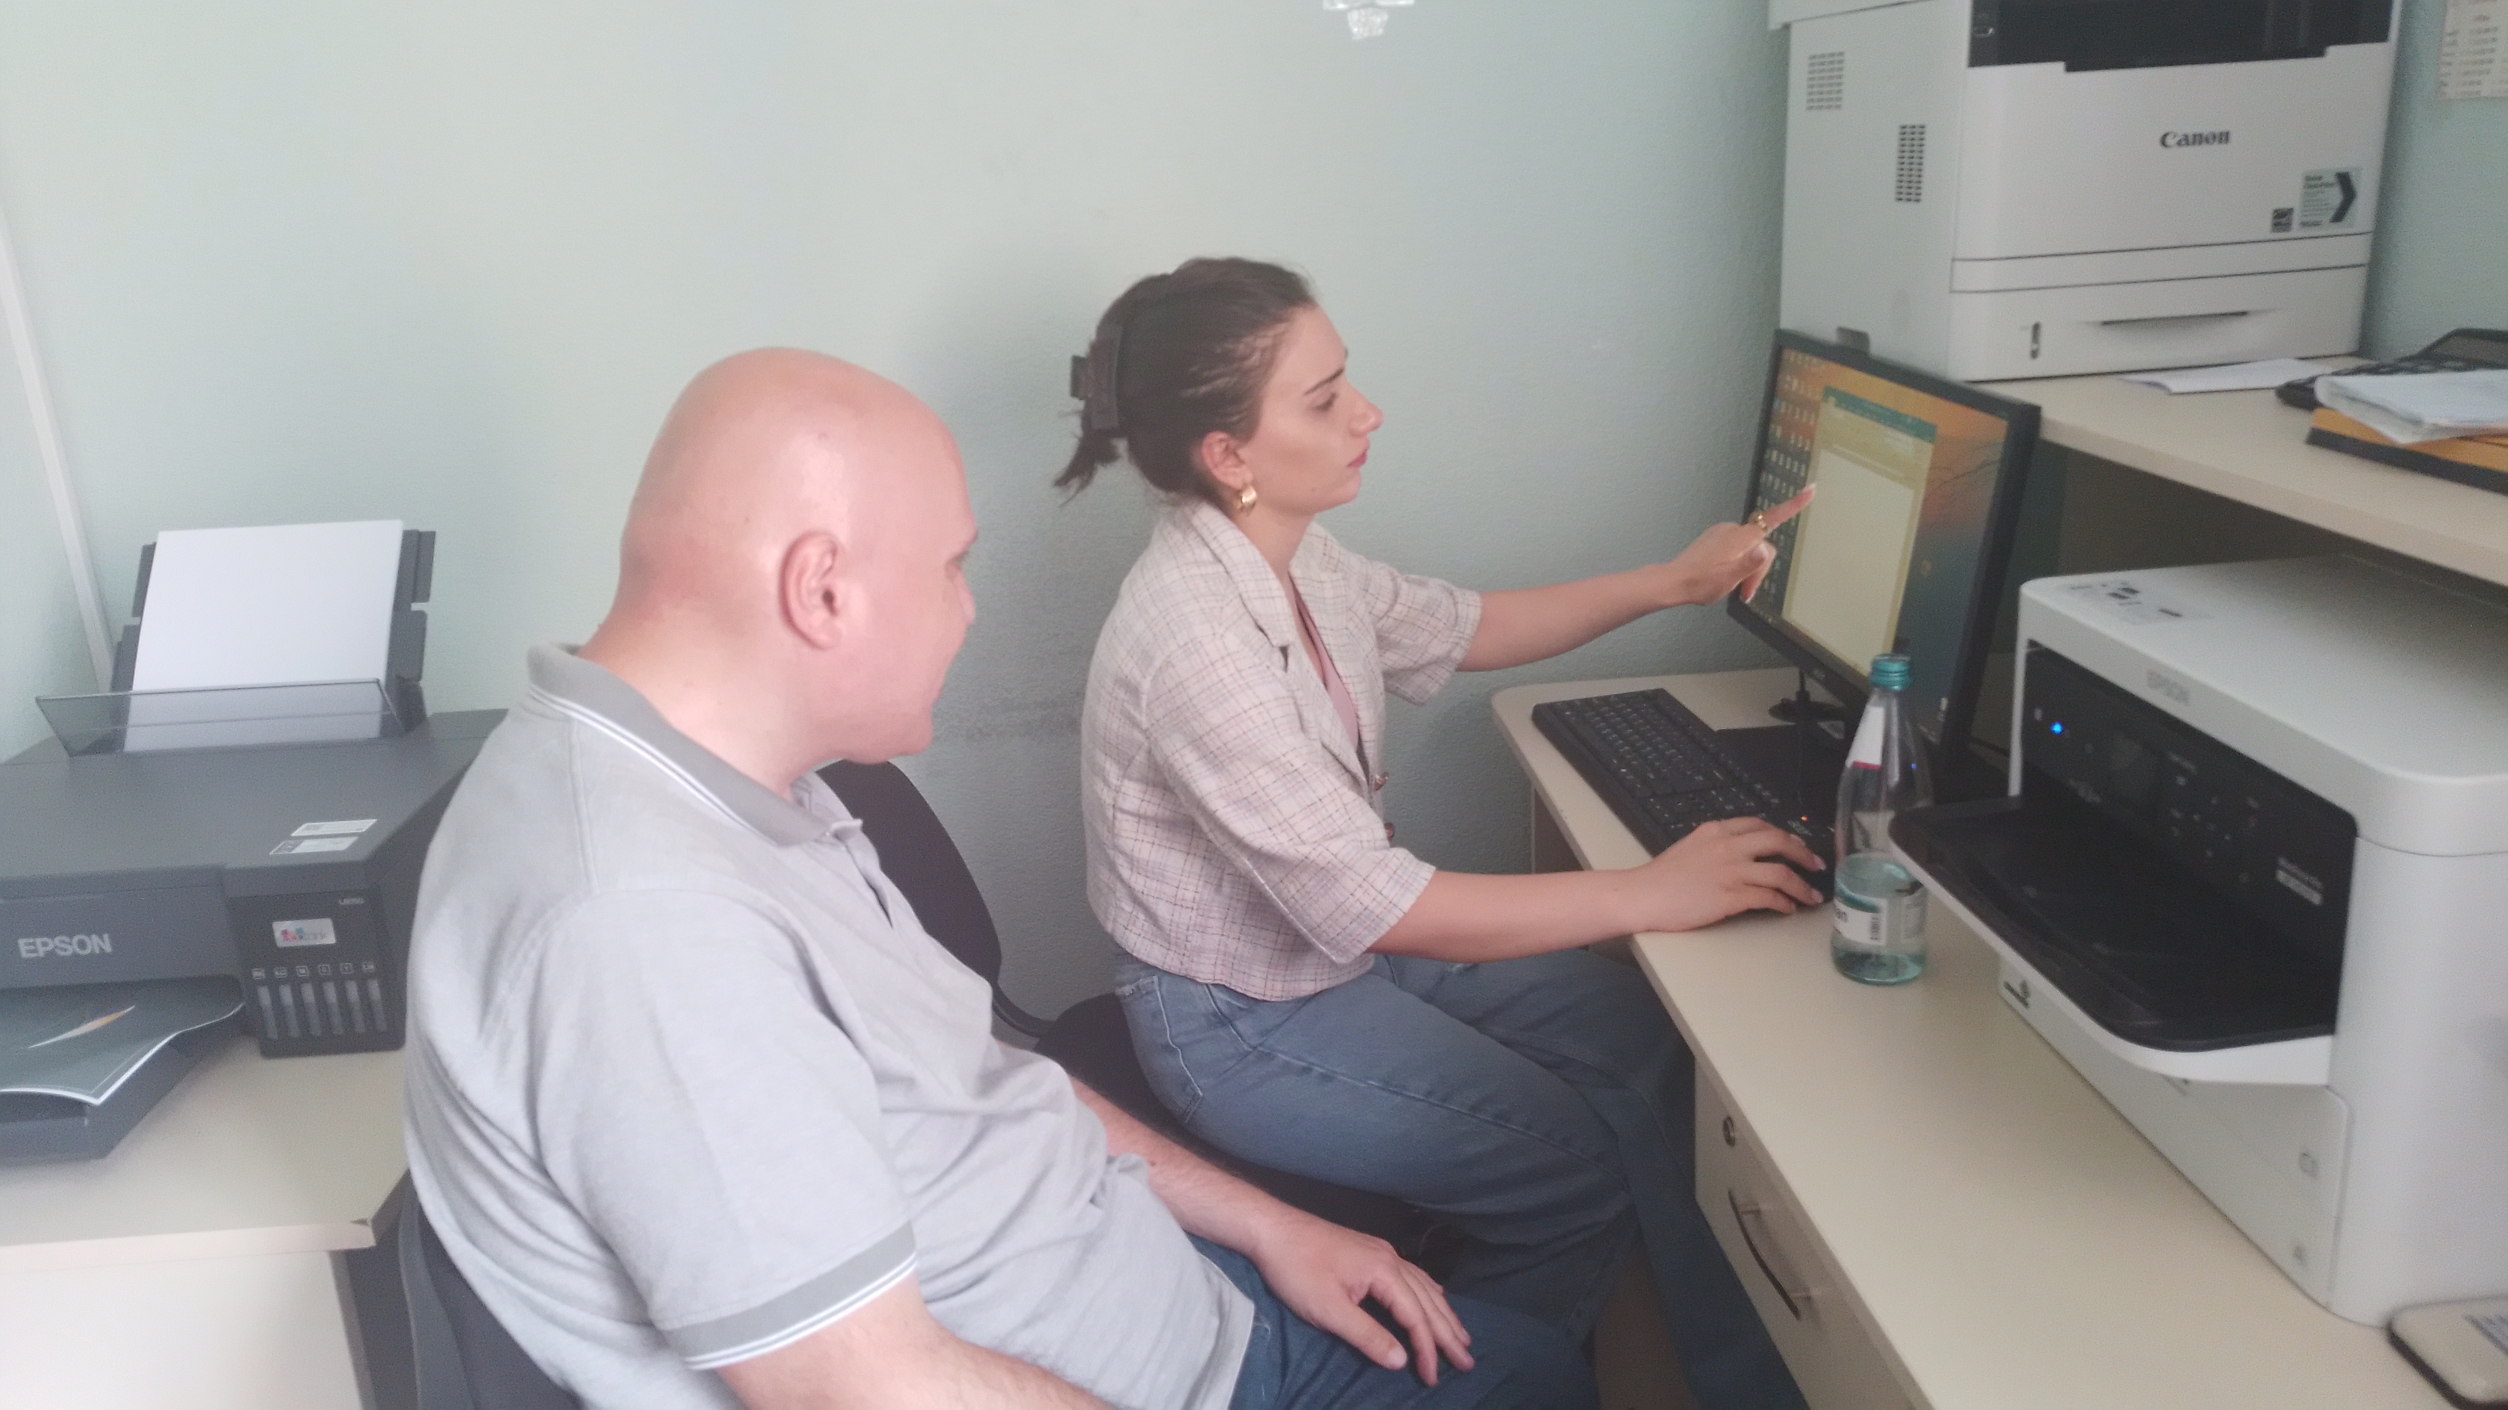
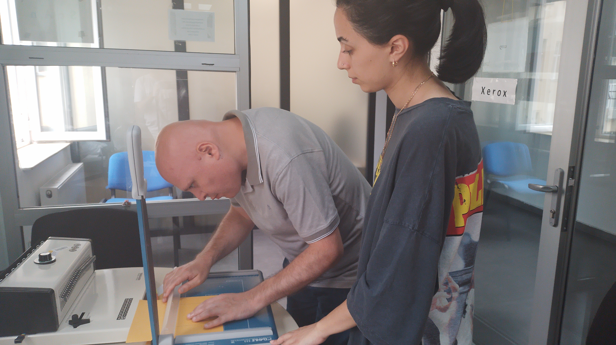
Polygraph Shop
Interactive Motivational Diary
https://youtu.be/ZSVMT-NZ_Vs

Slide 11


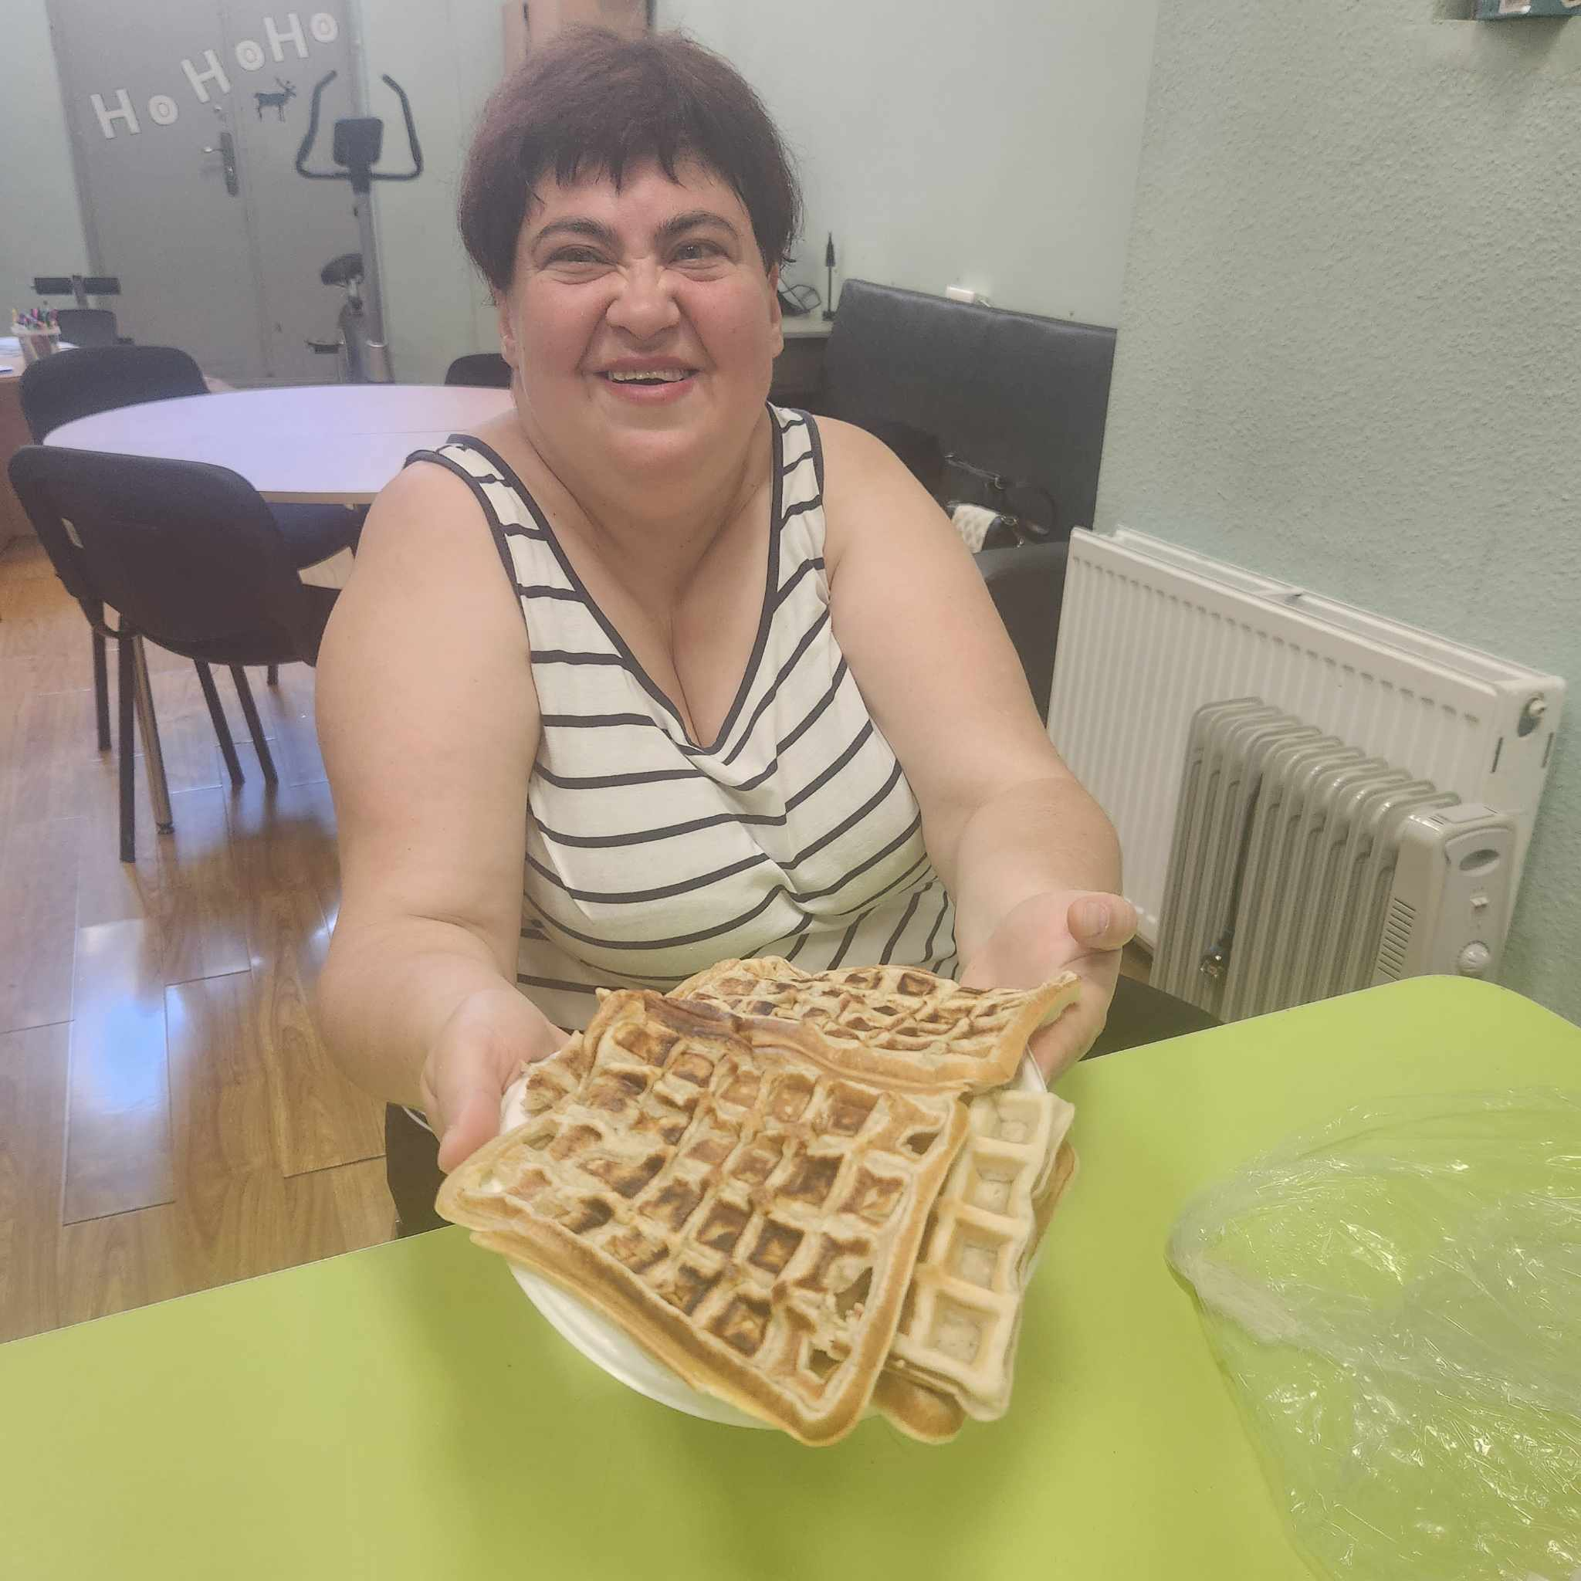

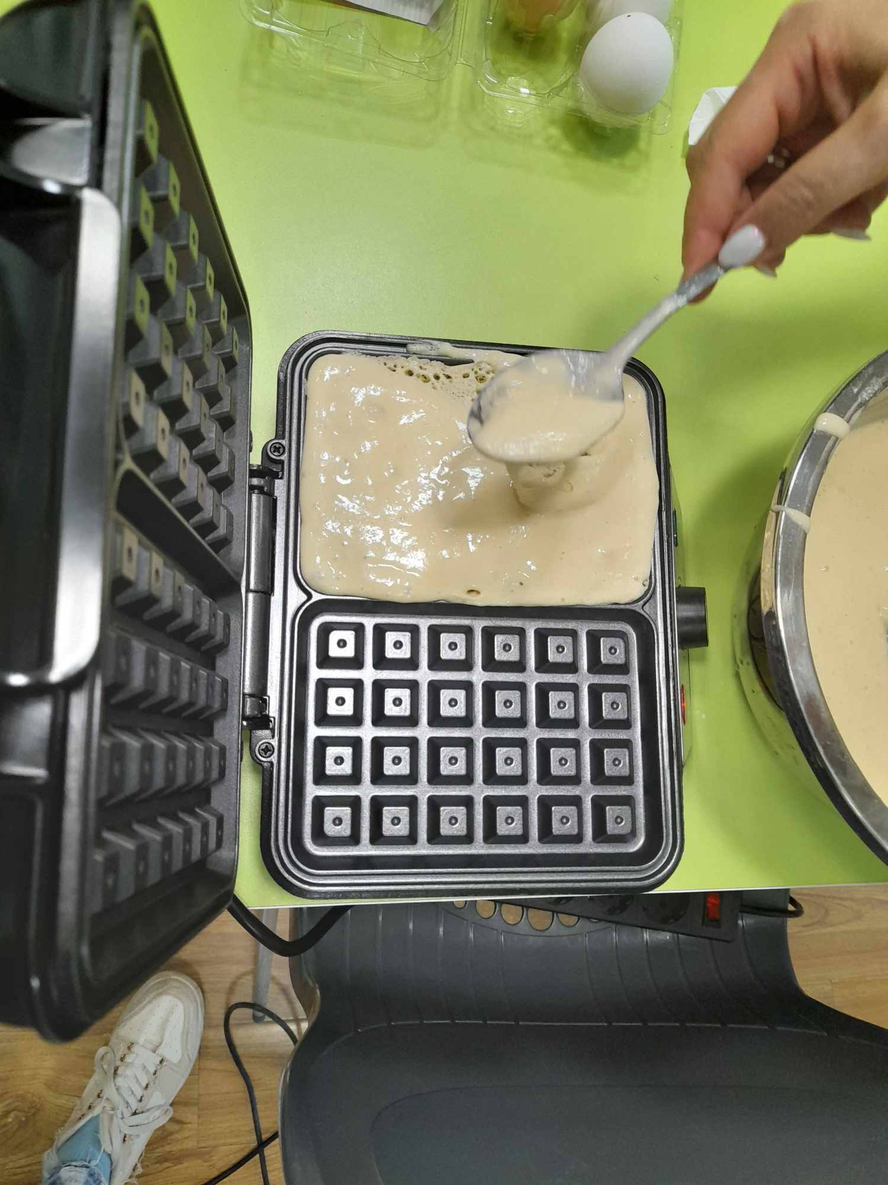
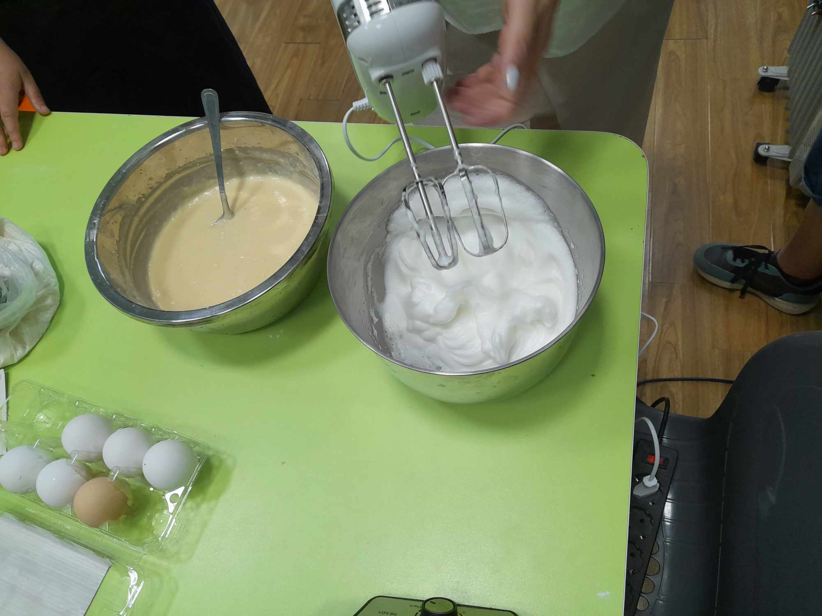
Health Food Corner
Toasts, Belgian Waffle, Smooth
https://youtu.be/zZWfTWldNnA

Slide 12


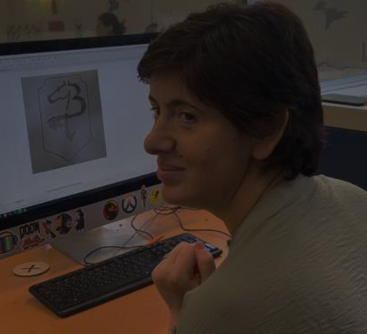


Fine Arts Lab
Sketch- 3D Printing
https://youtu.be/dnP1lJjdYu0

Slide 13
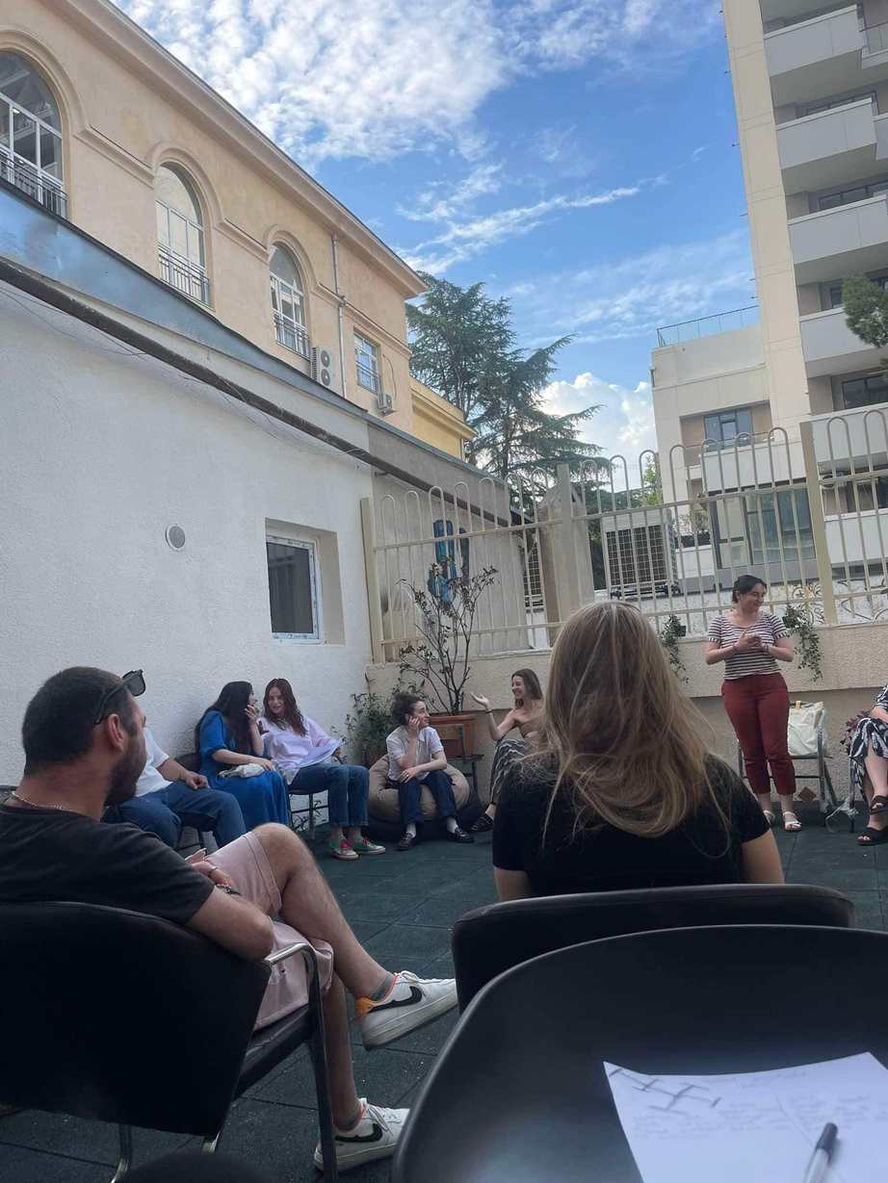
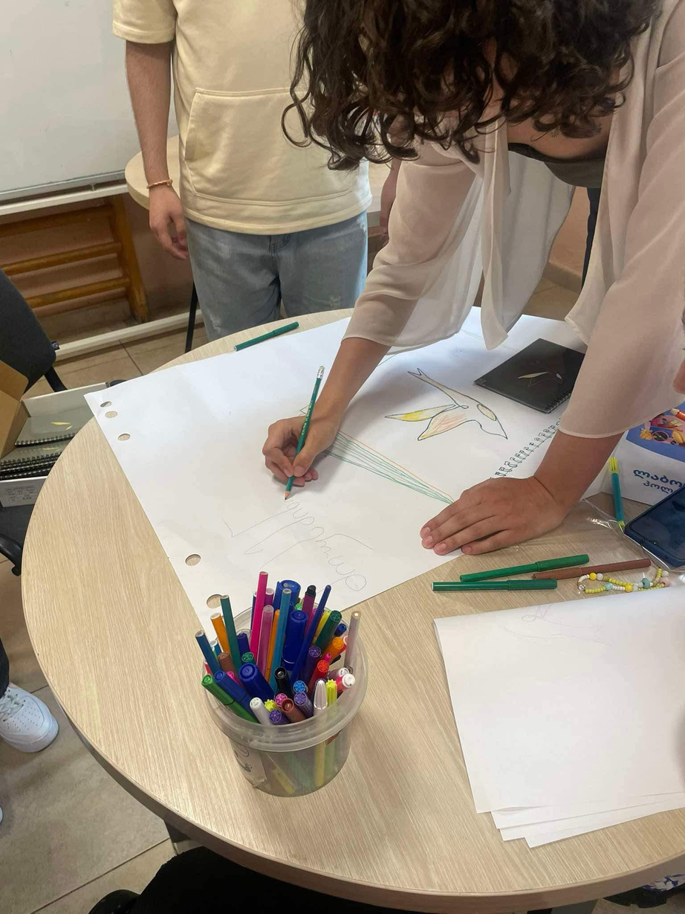
Garden of Meetings
Group Facilitation
Warming up activity
https://youtu.be/oGSQT9hVkgI

Slide 14
Role of Psychologist (Job Coach)
Multidciplinary Work
Rapport with Job Candidate (JC)
Clinical reasoning and case analysis and use professional strategies to interpret data
and study
work methodologies.
Assess work environments using specific assessment techniques.
Design and evaluate the work profile of individuals.
Facilitate job requalification and return to work.
Carry out work and job analysis in the work environment using specific tools and
methodologies to
facilitate work participation.
Use Vocational habilitation/rehabilitation methods to improve work participation
Notes:
Job' refers to a specific activity that one does to earn a living, synonymous with 'profession' or 'occupation'. However, 'work' refers to any activity, whether it's mental or physical. All jobs can be considered work, but not all work is a job. 'Work' can be used as a noun or a verb, while 'job' is always a noun.

Slide 15
Role of Social Worker (Social Pedagogy)
Multidciplinary Work
Trust Building (Rapport)/Effective Communication with Job Candidate (JC)
Assessment of social skills and employability of JC
Educational Work - promoting access to existing services/job market
Social Integration of JC with group members/job environment
Use the core concepts of social entrepreneurship for employment.
-Design community projects oriented to employment.

Slide 16
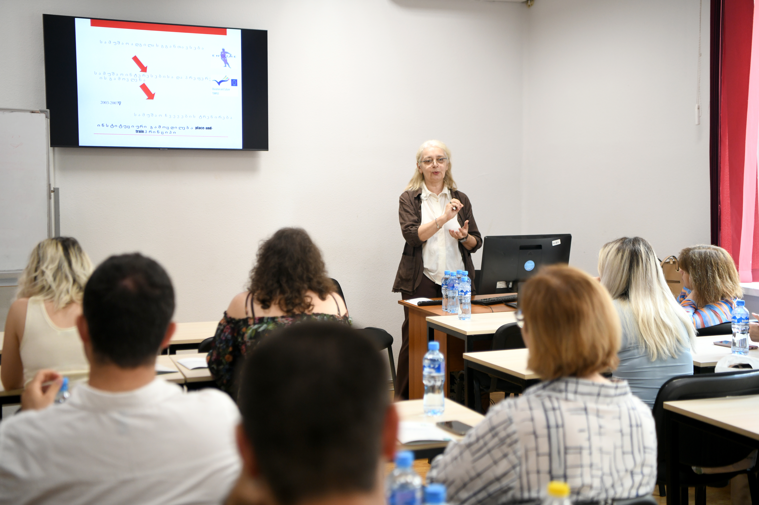

NETWORKING - MODI
Notes:
12 th of July 2024

Slide 17
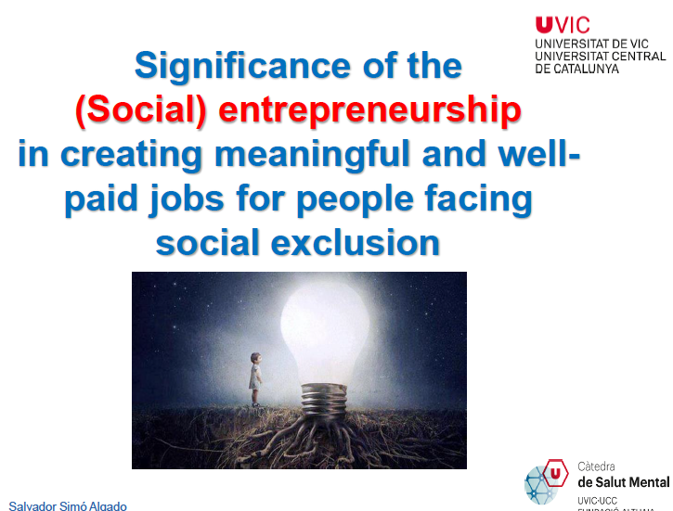


Slide 18
Thank YOU !
Questions!
Thoughts!
Comments!

