Slide 1
IMPLEMENTING INNOVATIVE PROJECT FOR SOCIAL WORK AND PSYCHOLOGY ACADEMIC PROGRAMS: “LEARNING LABS FOR EQUAL RIGHTS”
Dr. Shorena Sadzaglishvili
Ilia State University
shorena_sadzaglishvili@iliauni.edu.ge

Slide 2
GRANT #CIF-2023-04
Learning Labs for Equal Rights
09.2023 - 08.2025

Slide 3


Slide 4
International and Local Partners
Rudolf Steiner University College, Norway
Autonomous University of Barcelona (EUIT-UAB).
University of Vic, Central University of Catalonia (UVic-UCC)
Gori State University – Consortium

Slide 5
PROJECT AIMS
Create a multidisciplinary/multi-professional learning practical laboratories (hubs) in two universities of Georgia for promotion of PWDs social integration and involvement in the supportive community;
PWDs: Promote employment in the higher education system for PWDs (assessment of project results using visual methods)
Students: Practice placement for psychology and social work students – service learning
Teaching: Updated syllabuses, improved learning and teaching processes – innovative teaching
Professional Development: Develop a continuous education program for service managers and providers who are interested in employing 18+ PWDs
Inter-disciplinarity

Slide 6
Disability Issues in Georgia: Unemployment
Gradual decline from ~17% in 2022 down to 13.9% in 2024 .
118,651 persons with disabilities were registered as recipients of state social assistance in Georgia, which is about 3% of the total population of Georgia. (Ministry of health, March 1, 2015)
World Health Organization: 10%
In 2021, an interagency coordination committee was established with the aim of promoting the implementation of the UN Convention on the Rights of Persons with Disabilities (Government of Georgia, 2023). It defines the fundamental principles and mechanisms for ensuring access for persons with disabilities to independent living and full participation in all areas of life, without discrimination and on an equal basis with others. Article 11 specifically addresses the right to work and employment, as well as the protection and realization of this right.
Interagency Coordinating Committee for the Implementation of the Convention on the Rights of Persons with Disabilities- Ministry of Labor, Health and Social Protection of IDPs from the Occupied Territories of Georgia: (6)
◻Employment ◻ Health care ◻ Biopsychosocial Model ◻ Deinstitutionalization ◻ Improving the quality of services ◻ Decentralization of services
Inclusive Education - Vocational Education – Employment
Intermediary service between vocational schools and places of employment
The State Vocational Skills Agency of Georgia - (Education) - to enhance access to vocational education and employment opportunities for persons with disabilities (PwDs). Inclusive teaching, adaptive curricula.
Social Assistant – accompany the person (Health)
the State Employment Agency (Health) Supported Employment Coordinator Position
Systematic Approach to Employment
People with special needs and People /persons with disabilities

Slide 7
Disability Employment
The role of a supported employment consultant is, on the one hand, to identify job-seeking persons with disabilities and, on the other hand, to assess their abilities, interests, and support needs. Following this assessment, the consultant assists with job searching, resume preparation, and, if necessary, provides on-the-job consultation to support the development of the employee's skills (Government of Georgia, 2022).
The law also provides for the creation of a sheltered workplace when needed, which refers to an adapted environment for persons with disabilities, ensured by the employer in coordination with the state employment support agency. A sheltered workplace may also involve a special vacancy that can only be filled by a person with a disability (Parliament of Georgia, 2020).
The employment support program includes a component for wage subsidies, aiming to subsidize the wages of beneficiaries employed in new or existing vacant positions through agreements with employers. This initiative specifically aims to promote the employment of persons with disabilities and persons with special educational needs (Government of Georgia, 2022).
In addition to wage subsidies, the Government of Georgia’s resolution on the approval of the State Employment Support Program also provides for the subsidization of sheltered workplaces. The aim is to create a work environment adapted to the needs of persons with disabilities, on the condition that the designated work environment will operate for a minimum of three years. The employment agency provides funding for the subsidization of the sheltered workplace, covering no more than 50% of the costs (Government of Georgia, 2022).

Slide 8
Statistics
In 2017, a total of 1,775 people were employed, of whom 103 were persons with disabilities.
In 2018, out of 1,888 employed individuals, 99 were persons with disabilities;
in 2019, 98 out of 1,415;
in 2020, 37 out of 908; and
in 2021, 115 out of 3,812 (3%) employed individuals were persons with disabilities (Public Defender, 2022).

Slide 9



Laboratory Staff – Inter-disciplinary Team
PWDs – in protected Environment /Job Candidate
Job Coach
Students (Psychology/Social Work)
Craft Teacher
Supervisors/Researchers – Psychology and Social Work

Slide 10
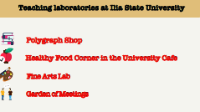
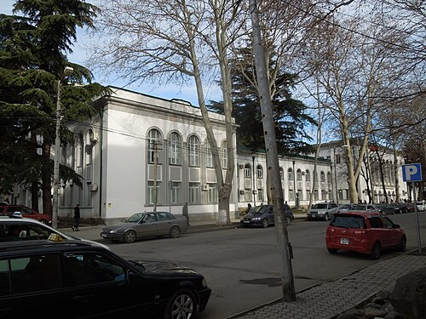

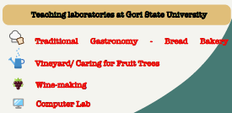
Polygraph Shop
Healthy Food Corner
Fine Arts
Garden of Meetings
Traditional Gastronomy
Vineyard
Wine Making
Computer Lab

Slide 11
The Main Principals of Work
Trinal Method (theory, practice, art)
Place and Train
Notes:
The "place and train" method involves placing individuals with disabilities directly into workplace environments where they receive on-the-job training and support. Rather than traditional classroom-based training programs, this approach emphasizes experiential learning within authentic work settings. Trainers and supervisors work closely with participants to teach job tasks, provide feedback, and gradually increase independence until the individual can perform the job duties competently (Lombardi & Nardone, 2011).

Slide 12
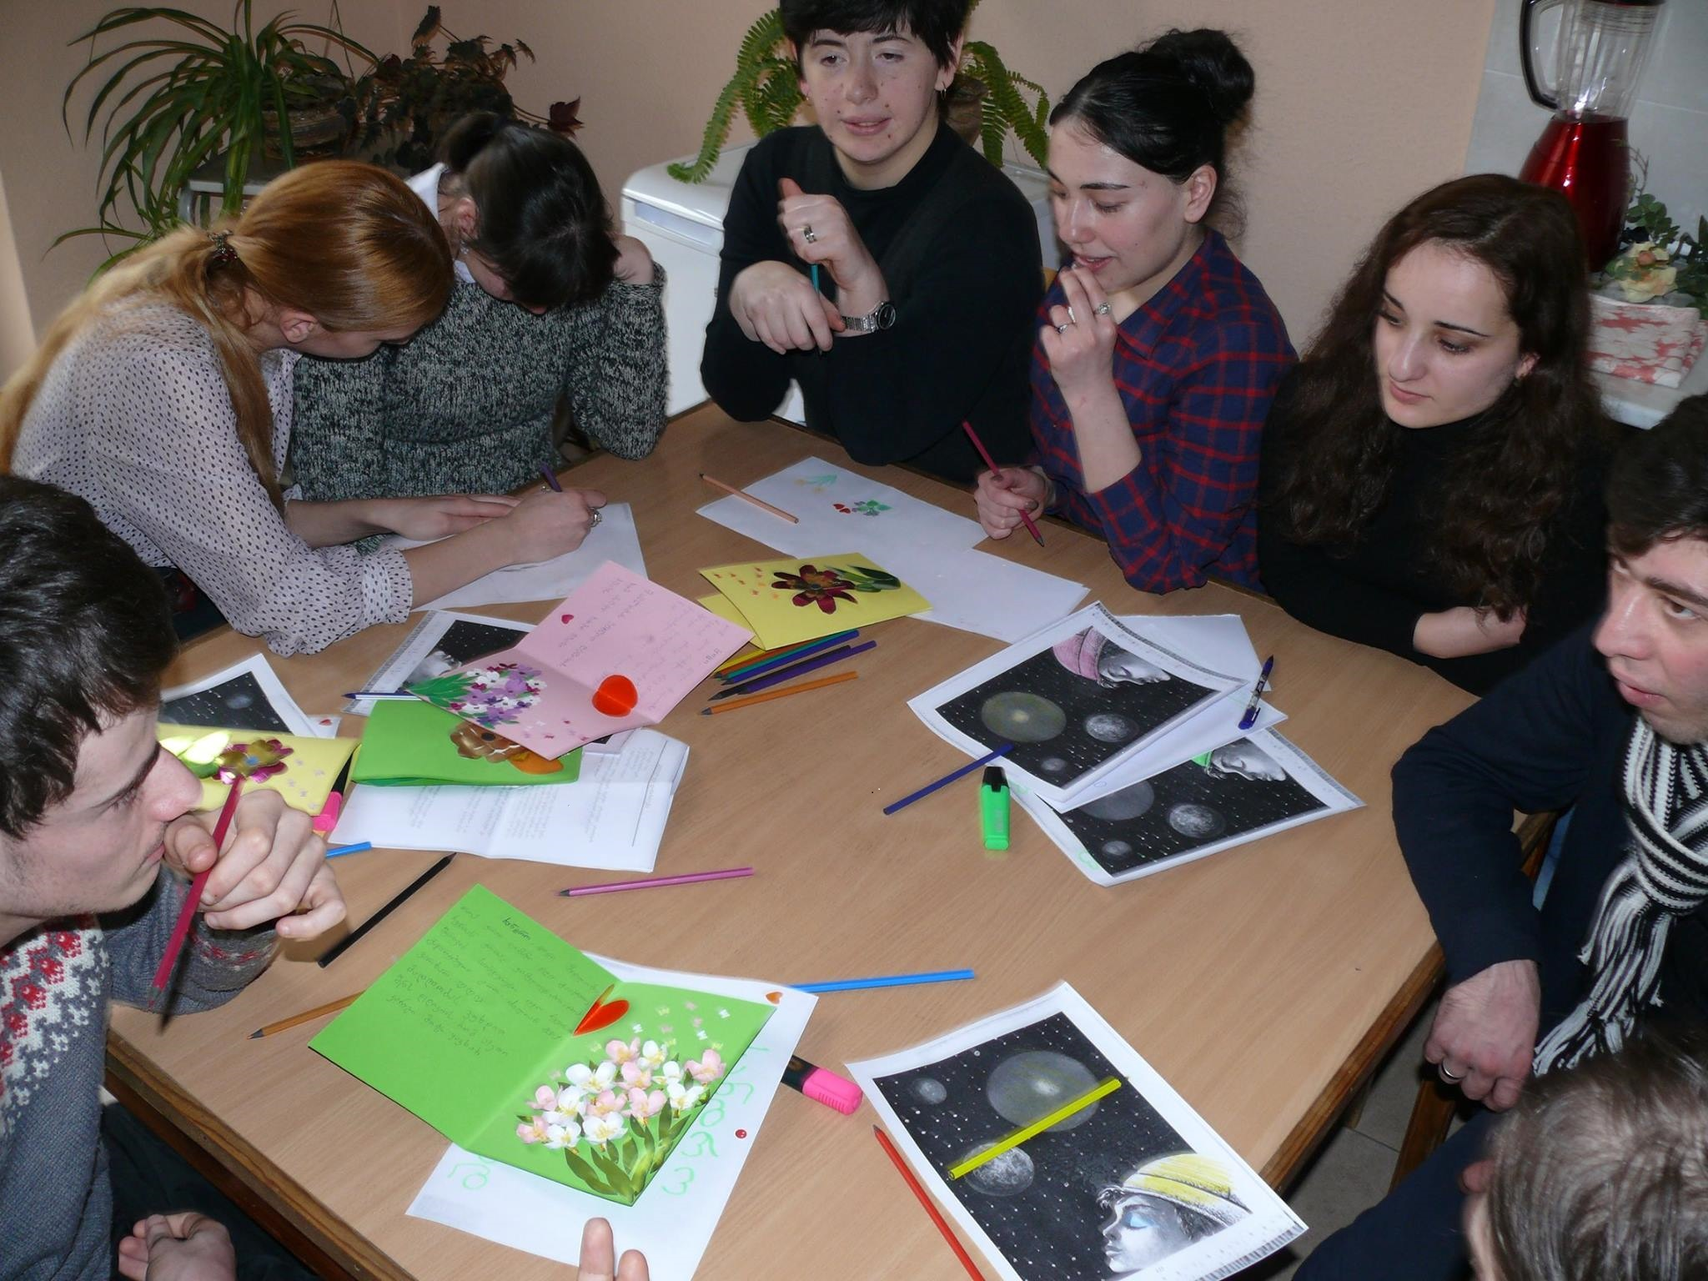
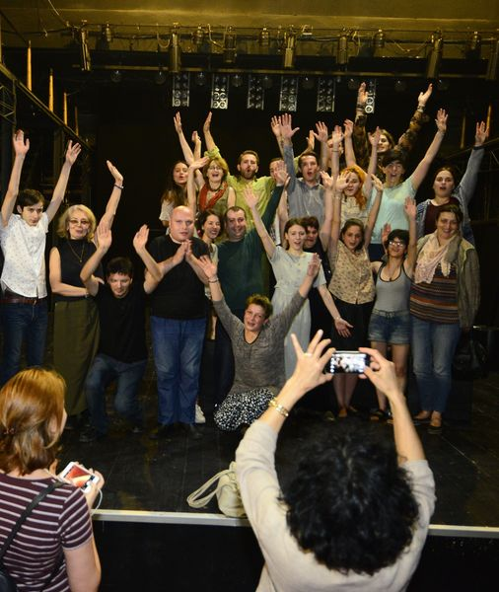
Innovative Teaching and Learning
Project Based Learning
Multi disciplinary
Group Work
Notes:
12

Slide 13
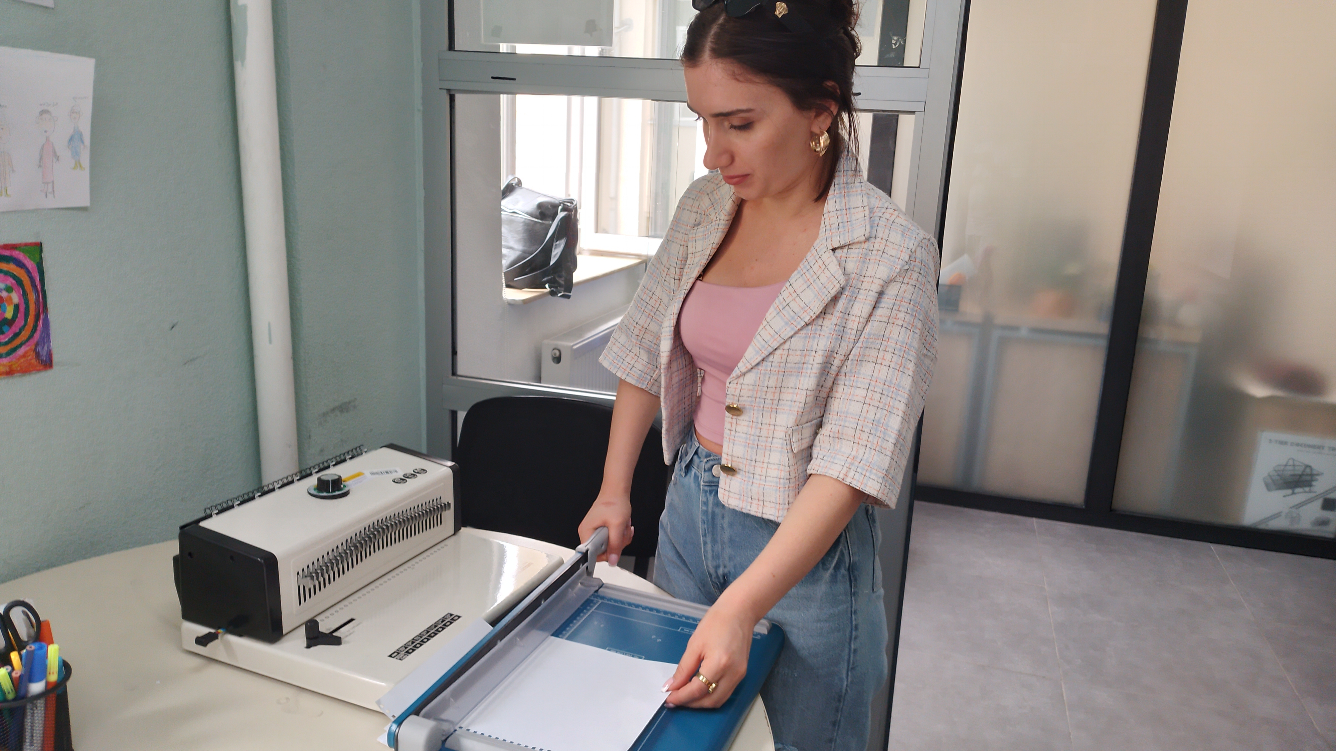

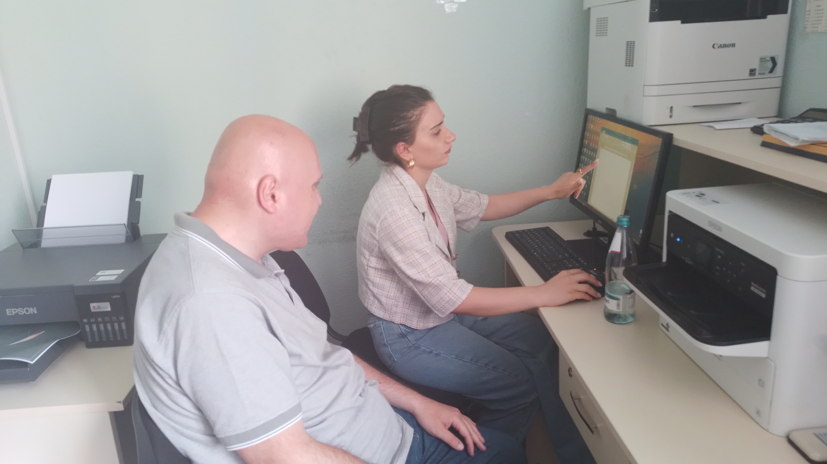
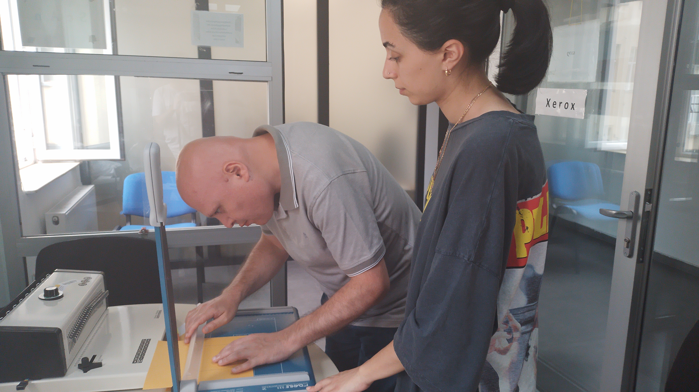
Polygraph Shop
Interactive Motivational Diary
https://youtu.be/ZSVMT-NZ_Vs

Slide 14


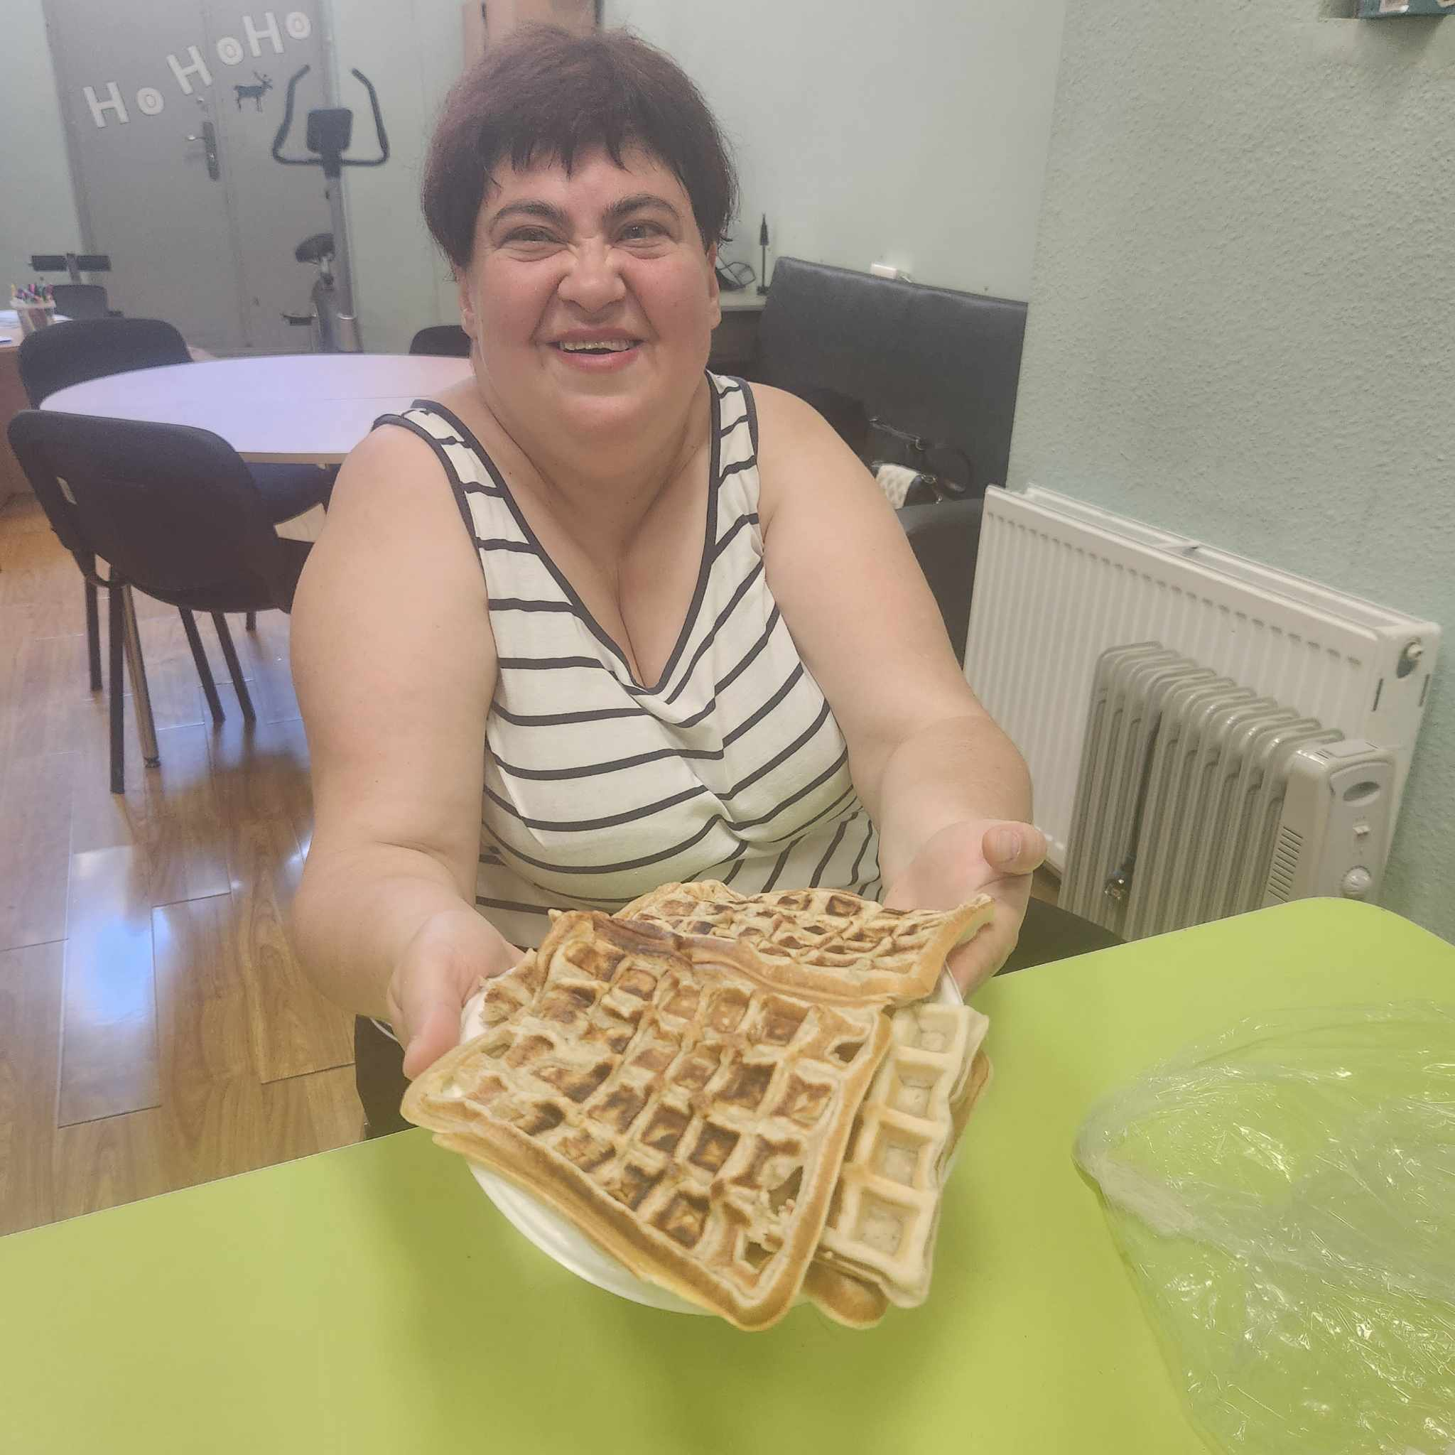

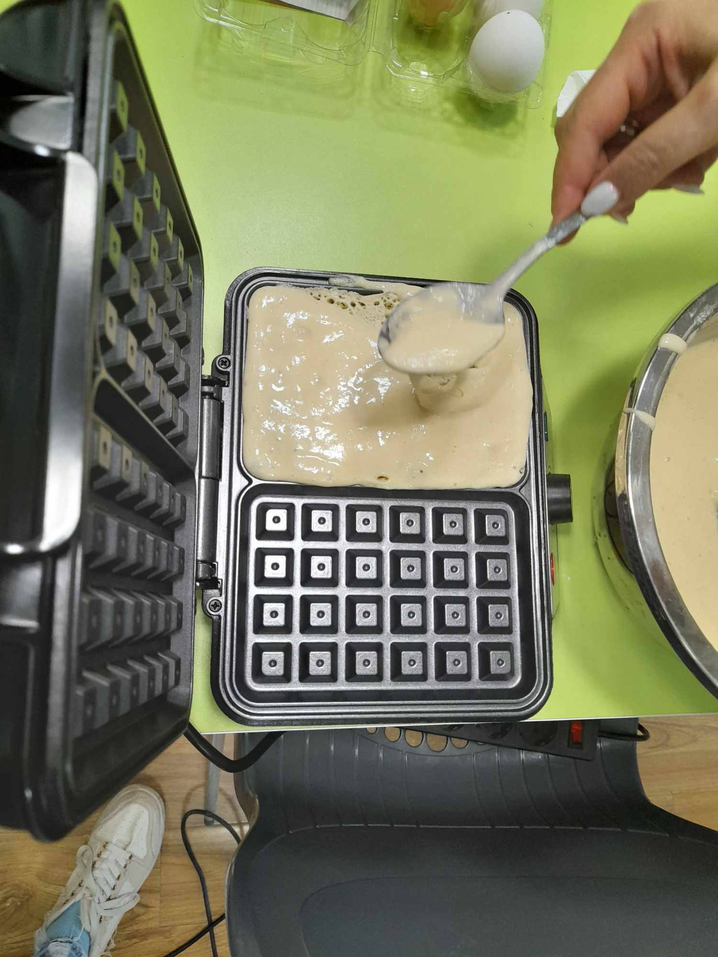
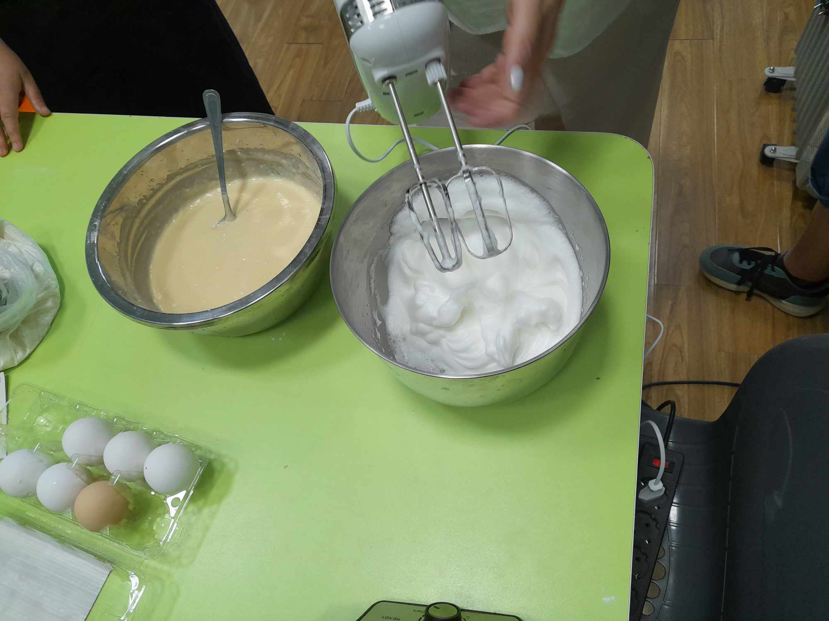
Health Food Corner
Toasts, Belgian Waffle, Smooth
https://youtu.be/zZWfTWldNnA

Slide 15
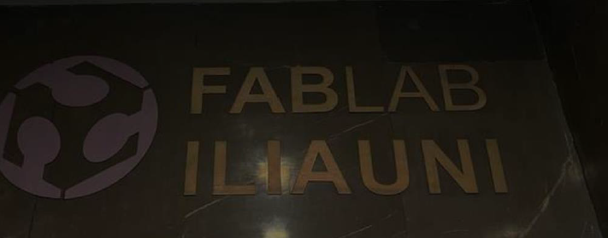

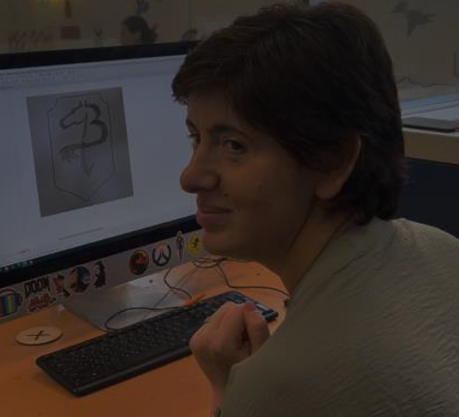
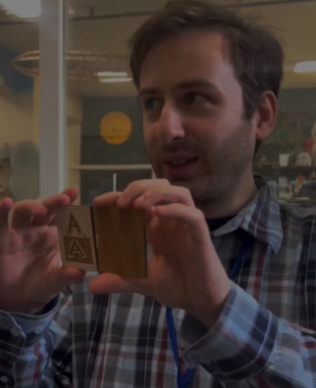

Fine Arts Lab
Sketch- 3D Printing
https://youtu.be/dnP1lJjdYu0

Slide 16
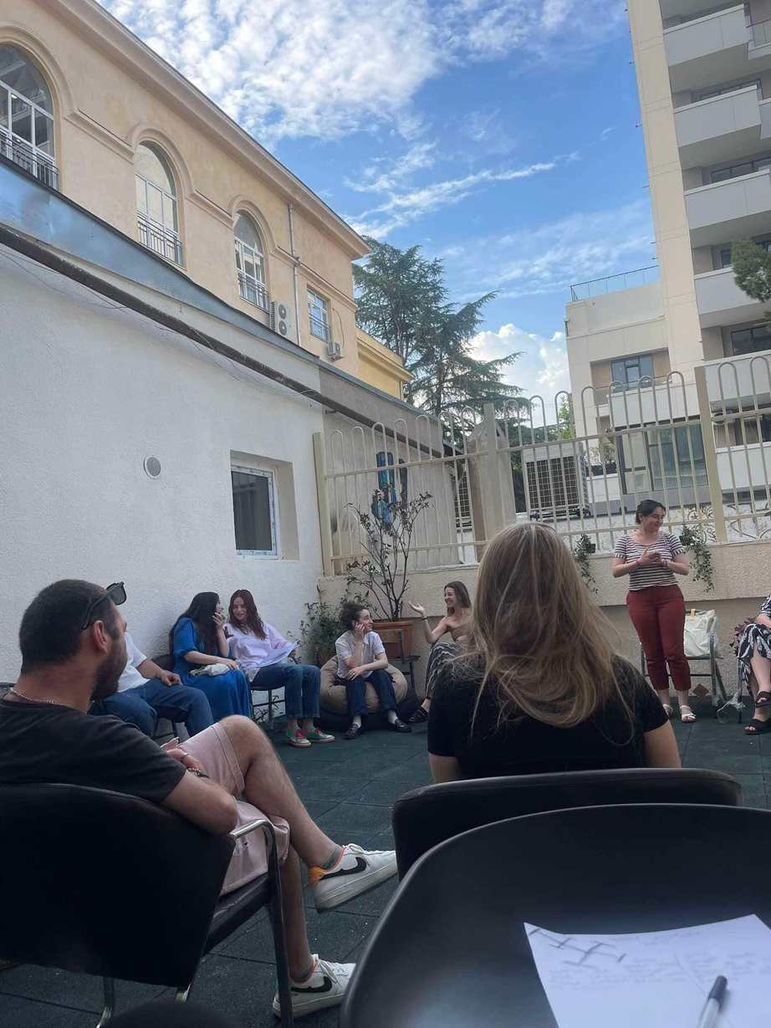
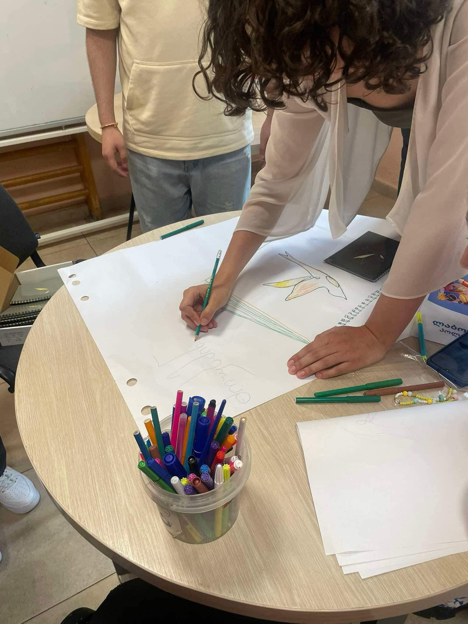
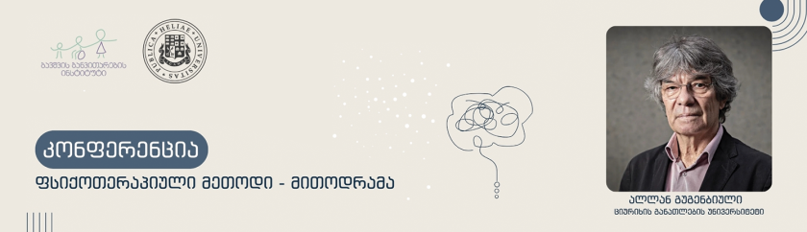
Garden of Meetings
Group Facilitation
Warming up activity
https://youtu.be/oGSQT9hVkgI

Slide 17
  Role of Psychologist (Job Coach)
Multi disciplinary Work
Rapport with PWD
Clinical reasoning and case analysis and use professional strategies to interpret data
and study
work methodologies.
Assess work environments using specific assessment techniques.
Design and evaluate the work profile of individuals.
Facilitate job requalification and return to work.
Carry out work and job analysis in the work environment using specific tools and
methodologies to
facilitate work participation.
Use Vocational habilitation/rehabilitation methods to improve work participation
Notes:
Job' refers to a specific activity that one does to earn a living, synonymous with 'profession' or 'occupation'. However, 'work' refers to any activity, whether it's mental or physical. All jobs can be considered work, but not all work is a job. 'Work' can be used as a noun or a verb, while 'job' is always a noun.

Slide 18
  Role of Social Worker (Social Pedagogy)
Multidciplinary Work
Trust Building (Rapport)/Effective Communication with PwD
Assessment of social skills and employability of PwD
Educational Work - promoting access to existing services/job market
Social Integration of PwD with group members/job environment
Use the core concepts of social entrepreneurship for employment.
-Design community projects oriented to employment.

Slide 19
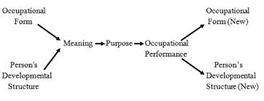
The coincidence of the person's development structure and the occupational form creates a meaning, which is a comprehensive interpretive experience involving the individual’s engagement with the occupational form.
David Nelson - 1988
"Theoretical Occupational Conceptual Framework."
The occupational form is a set of external physical and socio-cultural environmental conditions indicating what an individual should do.
The implementation of occupation depends on developmental structure.

Slide 20
University (ADS)
Laboratories (WEIS)
Individual (COPM)

Slide 21
Research questions: (Mixed Methodology)
What are the attitudes of Ilia State University and Gori State University employees towards people with disabilities and their employment?
What impact do physical environment factors have on the functional activities of people with disabilities in a protected work environment?
What types of socio-cultural occupational forms are observed at supported employment sites?
How much has the quality of work performed by persons with disabilities improved?

Slide 22
the Georgian-adapted version of the Attitude to Disability Scale (ADS)
Inclusion domain consisted of 4 items (Cronbach’s α = 0.6), | People with a disability find it harder than others to make friends | People with a disability have problems getting involved in society | People with a disability are a burden on society | People with a disability are a burden on their family
Discrimination domain consisted of 4 items (Cronbach’s α = 0.8) | People often make fun of disabilities | People with a disability are easier to take advantage of (exploit or treat badly) compared with other people | People tend to become impatient with those with a disability | People tend to treat those with a disability as if they have no feelings
Power MJ, Green AM; WHOQOL-DIS Group. The Attitudes to Disability Scale (ADS): development and psychometric properties. J Intellect Disabil Res. 2010 Sep;54(9):860-74. doi: 10.1111/j.1365-2788.2010.01317.x. PMID: 20712699.

Slide 23
the Georgian-adapted version of the Attitude to Disability Scale (ADS)
Gains domain consisted of 4 items (Cronbach’s α = 0.6) | Having a disability can make someone a stronger person | Having a disability can make someone a wiser person | Some people achieve more because of their disability (e.g. they are more successful) | People with a disability are more determined than others to reach their goals
Prospects domain consisted of 4 items (Cronbach’s α = 0.8) | Sex should not be discussed with people with disabilities | People should not expect too much from those with a disability | People with a disability should not be optimistic (hopeful) about their future | People with a disability have less to look forward to than Others

Slide 24
Work Environment Impact Scale WEIS
The first version of WEIS was developed in Chicago in 1996, and the second version was launched in 1998 [Moore-Corner et al, 1998]. WEIS was edited and translated into Swedish in 1997, and is available today in a third Swedish version [Ekbladh & Haglund, 2010]. Psychometric testing of the construct validity of WEIS has been carried out [Corner et al, 1997; Kielhofner et al, 1999; Ekbladh et al, 2014], in which the instrument obtained good results. Another study [Ekbladh et al, 2010] showed that WEIS can be used to identify work environment factors that support or impede individuals’ well-being and execution of work.
The WEIS scale (Work Environment Impact Scale) was developed as a combined research method in 1998.
The purpose of WEIS is to assist therapists in gathering information on how individuals with physical or psychosocial disabilities experience and perceive their work environments. It measures the environment’s impact on a particular worker through items addressing work performance, satisfaction, and physical, emotional and social well-being.

Slide 25

Introduction to the COPM
The Canadian Occupational Performance Measure (COPM) is a client-centred outcome measure.
Semi-structured interview format and structured scoring.
Designed to detect change in a client’s self-perception of occupational performance over time.
Measures performance and satisfaction in self-care, productivity, and leisure.
Used across all ages and types of disability.

Slide 26
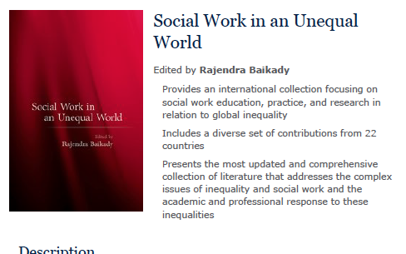
https://global.oup.com/academic/product/social-work-in-an-unequal-world-9780197807538?cc=ge&lang=en&#

Slide 27

Title: Attitudes Toward Disability and Inclusive Environments in Georgian
Universities: A Cross-Sectional Study of Administrative Staff
Authors: Shorena Sadzaglishvili *, Ketevan Makashvili, Ketevan Gigineishvili,
Ruizan Mekvabidze, Zurab Zurabashvili

Slide 28
Results: (N=63)
Staff with longer tenures tended to have less favorable attitudes towards employment of PwDs.
Female staff exhibited more positive attitudes towards Inclusion domain.
Staff at central universities were more likely to accept PwDs in the workplace and were more willing to employ them compared to their counterparts at regional universities.
Younger staff (18-34 years) demonstrated higher levels of acceptance and greater willingness to employ PwDs than older staff members (35-49 years and 50+ years), confirming the positive relationship between youth and inclusive attitudes.
People with cognitive with barriers/difficulties, including intellectual and mental limitations have lowest mean scores on acceptance scale as well on willingness for employment.

Slide 29

Thank You!
shorena_sadzaglishvili@iliauni.edu.ge
This project (CIF-2023-04) is funded by Ministry of Education, Science and Youth of Georgia, “Innovation, Inclusion and Quality Project – Georgia I2Q”.
Notes:
© Copyright PresentationGO.com – Free Templates & Infographics for PowerPoint and Google Slides

